Slide 1

Welcome to Year 4
Miss Lea-Smith
Mrs Belfield
Mrs Lomas

Slide 2
This afternoon we will explore:
- Year 4 Topics
Our Class Texts
Subjects
Assessment
How can you help?
Questions

Slide 3
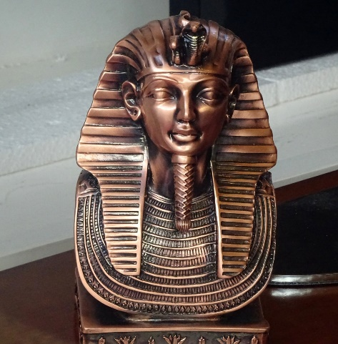
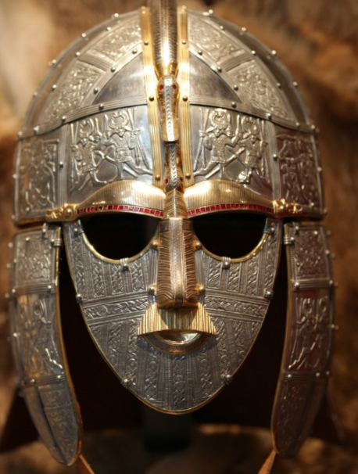
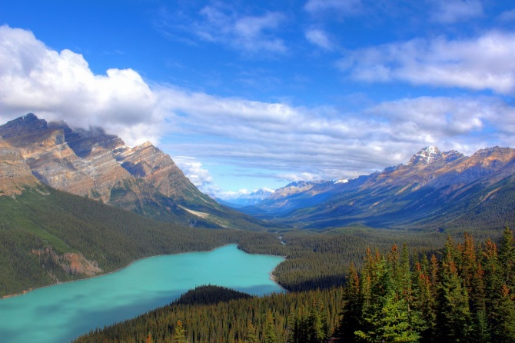
Ancient Civilisations
Invasion
This project teaches children about the characteristics and features of rivers and mountain ranges around the world, including a detailed exploration of the ecosystems and processes that shape them and the land around them.
This project teaches children about the history of three of the world’s first ancient civilisations: ancient Sumer, ancient Egypt and the Indus Valley civilisation. Children will learn about the rise, life, achievements and eventual end of each civilisation.
This project teaches children about life in Britain after the Roman withdrawal. Children will learn about Anglo-Saxon and Viking invasions up to the Norman conquest.
Misty Mountain, Winding River

Slide 4
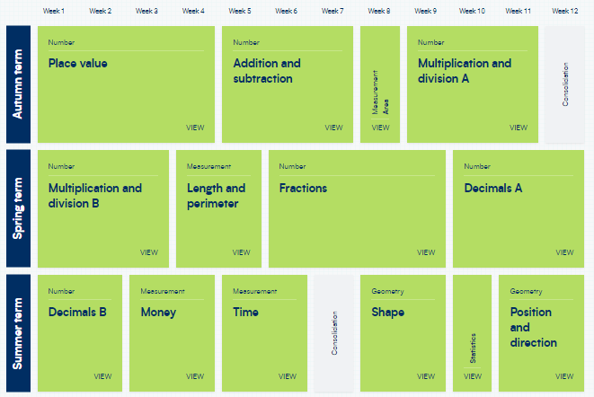
Maths

Slide 5
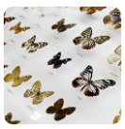
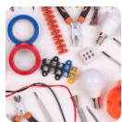



Science
Electrical
Conductors & Insulators
Grouping & Classifying
Sound
States of Matter
The Digestive System

Slide 6
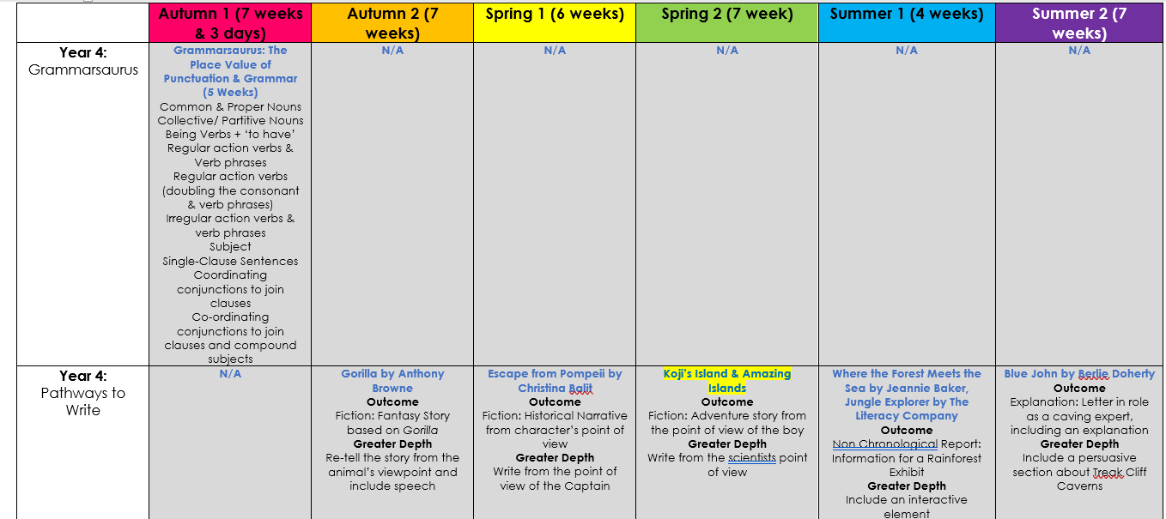
Writing

Slide 7


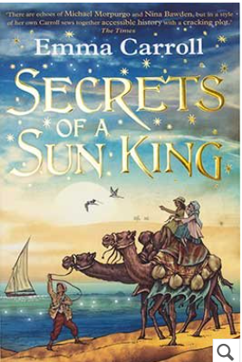
Harry Potter & the Philosopher’s Stone
Secrets of a Sun King
The Wind in the Willows

Slide 8
Reading is the gateway to the rest of the curriculum
Daily opportunities to read AR Book
Daily access to AR quiz
Reading books and diaries must come back to school every day
Expectation that children read at home every day and have their diaries signed.
Children can sign own diaries after independent reading
AR quizzes don’t only have to be on school books. Children can quiz on books they have read at home too.
5 Guided Reading lessons per week
Reading in all areas of the curriculum

Slide 9
P.E
Monday AM: Monday mornings – Bee Active
Friday PM – also with Bee Active
Children will need appropriate outdoor kit and will keep it on all day (black shorts/leggings and a plain red or white top)

Slide 10
Termly Assessment
Maths Assessment:
White Rose – Arithmetic Paper
White Rose – Reasoning Paper
Teacher judgement
Reading Assessment:
‘PIRA’ tests – written paper
Star Reading (ZPD) (Half Termly)
Teacher judgement
Writing Assessment –
Produce four/five formal pieces of writing (Writing Cycle)

Slide 11
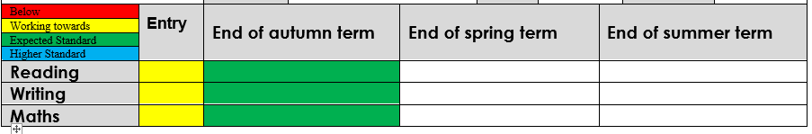
Assessment at Goldenhill
(B) Below
(WT) Working Towards
(EXP) Expected Standard
(HS) Higher Standard

Slide 12
Times tables
There is a huge emphasis on times tables in Year 4 as the children will take their Multiplication Tables Check (MTC) in June.
We will be practising times tables daily in class and the children will need to practice at home regularly – 10 minutes a night.
Children will be sent home with their log in details for Times Tables Rockstars (TTRS)

Slide 13
Important information about multiplication tables check (MTC)
◆ The MTC determines if Year 4 children can fluently recall their multiplication tables.
◆ They are designed to help schools identify which children require more support to learn their times tables.
◆ There is no ‘pass’ rate or threshold which means that, unlike the Phonics Screening Check, children will not be expected to re-sit the check.
◆ The Department for Education (DfE) will create a report about the overall results across all schools in England, not individual schools.

Slide 14
When the check will take place
◆ There will be a 2 week window from the beginning of June 2026 for schools to administer the check.
◆ There is no set day to administer the check and children are not expected to take the check at the same time.
◆ All eligible Year 4 children in England will be required to take the check.

Slide 15
How the check is carried out
◆ The check will be fully digital.
◆ Answers will be entered using a keyboard, by pressing digits using a mouse or using an on-screen number pad.
◆ Usually, the check will take less than 5 minutes for each child.
◆ The children will have 6 seconds from the time the question appears to input their answer.
◆ There will be a total of 25 questions with a 3 second pause in-between questions.
◆ There will be 3 practice questions before the check begins.

Slide 16
The check questions
◆ Each child will be randomly assigned a set of questions
◆ There will only be multiplication questions in the check, not division facts.
◆ The 6, 7, 8, 9 and 12 times tables are more likely to be asked.
◆ Reversal of questions (e.g. 8 x 6 and 6 x 8) will not be asked in the same check.
◆ Children will not see their individual results when they complete the check.

Slide 17
How can you help?
- Encouraging good presentation and on time completion of homework (Given out on a Thursday, due back on a Wednesday)
- Handwriting practise (cursive / fancy flicks)
Research about topics we are covering to gain a greater understanding e.g. The Vikings
- Reading at home (with and to your child)
Times table practise (up to 12 x 12) – Times table check in June
Encouraging children to look up spellings

Slide 18
Rewards
Daily | Weekly | Half - Termly
Mystery Student Dojos Marbles Weekly Texts home | Raffle Tickets (per 10 Dojos) Top Dojo Winner Star Reader Star Writer Merit Maths Champion Word Count Wall Dojo Record Cards | Marble Jar Treat Millionaire’s Club (1,000,000 words read) Top reader Most improved reader Dojo Shop

Slide 19
Thank You
Any questions?

