Slide 1

Welcome to the Early Years Unit!
Class Teachers: Mr Nicholls and Miss Mansell
Support Staff: Miss Everard and Miss Williams

Slide 2
What we will discuss:
A typical day in the unit.
Our values
Reward systems.
The areas of the curriculum.
Topics throughout year.
Our Numeracy Curriculum.
Little Wandle Foundations for Phonics.
Class Dojo

Slide 3
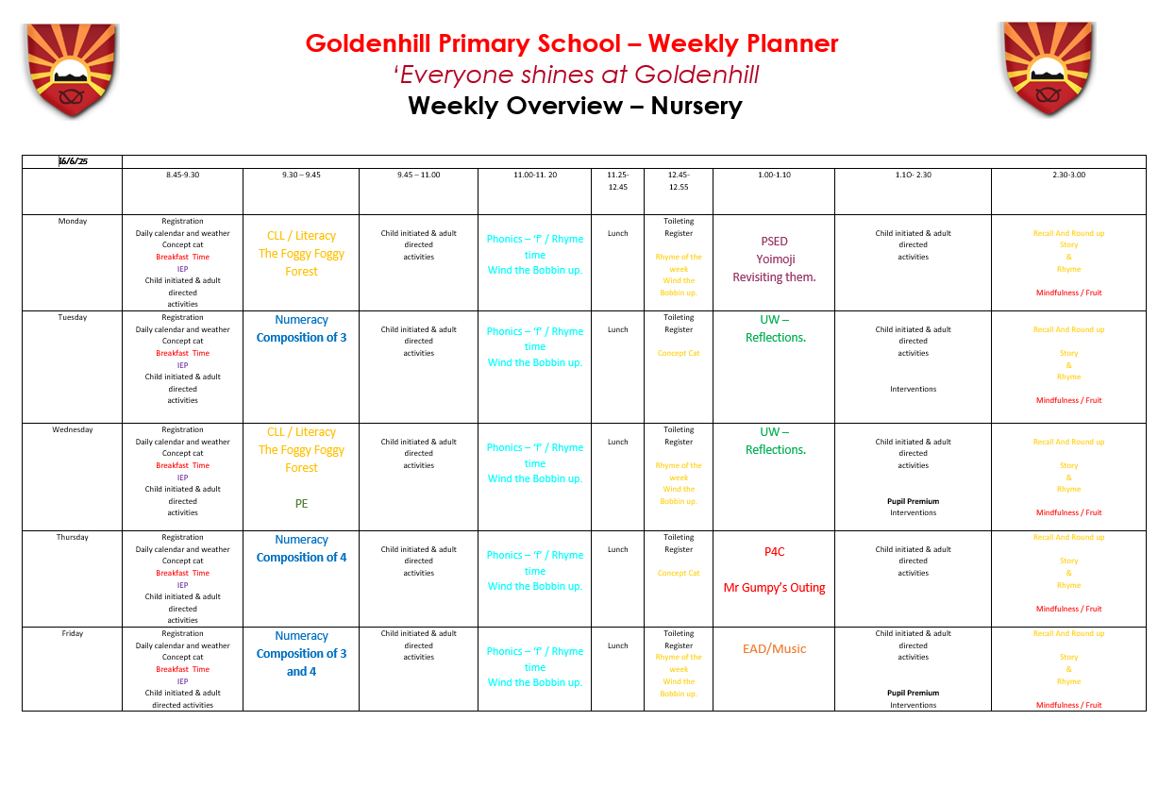
Our School Day

Slide 4
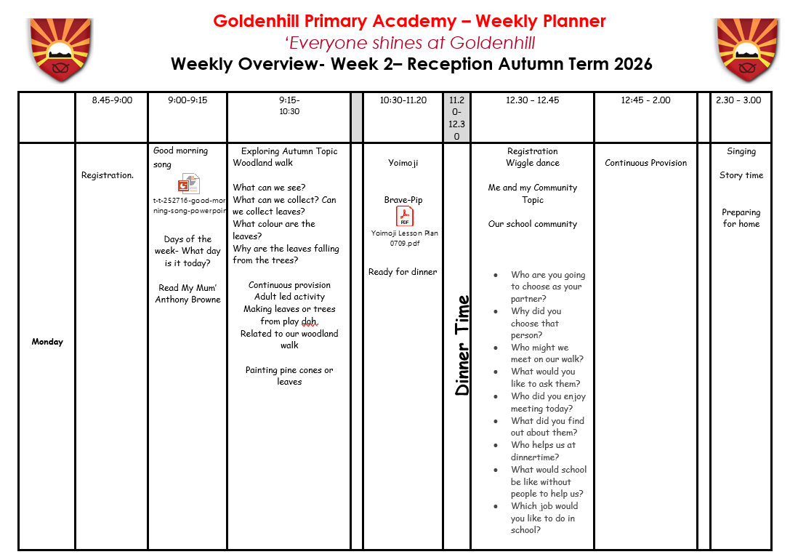
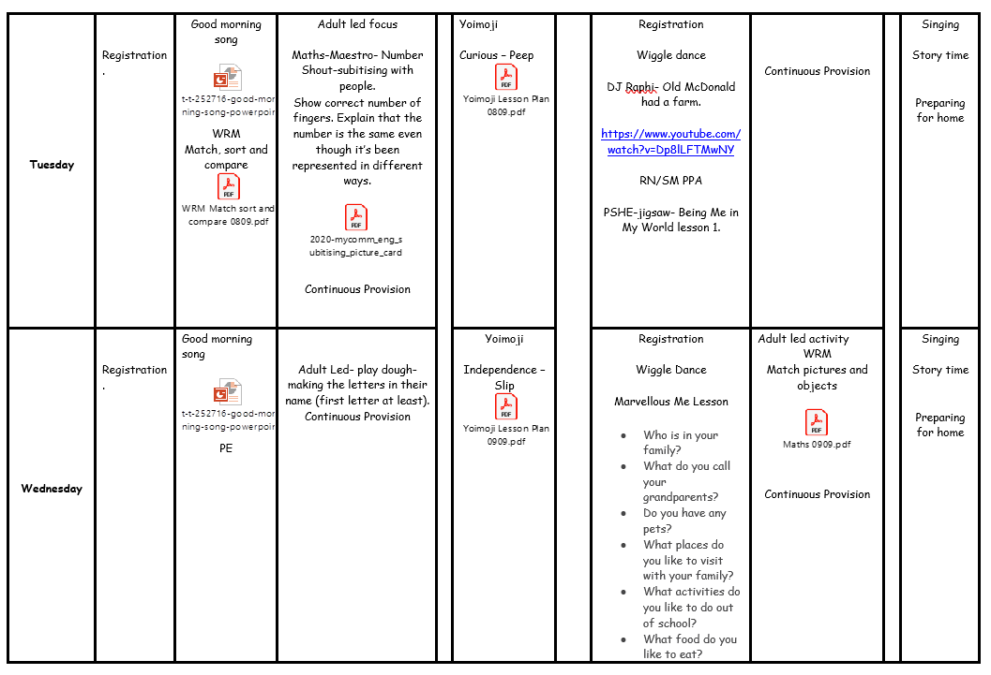

Slide 5
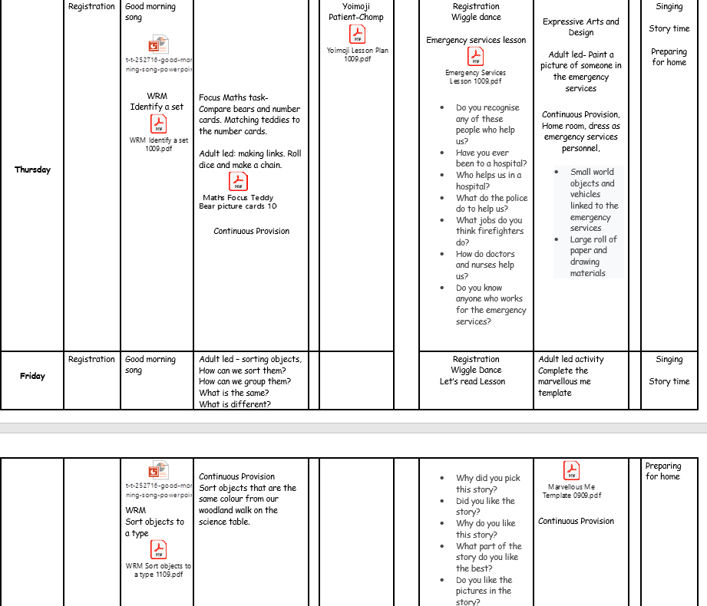

Slide 6
Morning and afternoon snack.
Morning snack this will consist of:
A yoghurt – dairy alternatives available.
Toast
Fruit
This will alternate over the week to provide a range of choice for the children.
Afternoon snack this will consist of:
Fruit.
The fruit tends to alter and we get a range which include: raisins, apples, oranges, carrots and bananas.
Children can bring their own healthy snack to enjoy during these times.

Slide 7


Slide 8

Our reward systems:
In Early Years we use Class Dojo as part of our reward system. When the children achieve 10 dojos they receive a prize out of our class prize box.

Slide 9
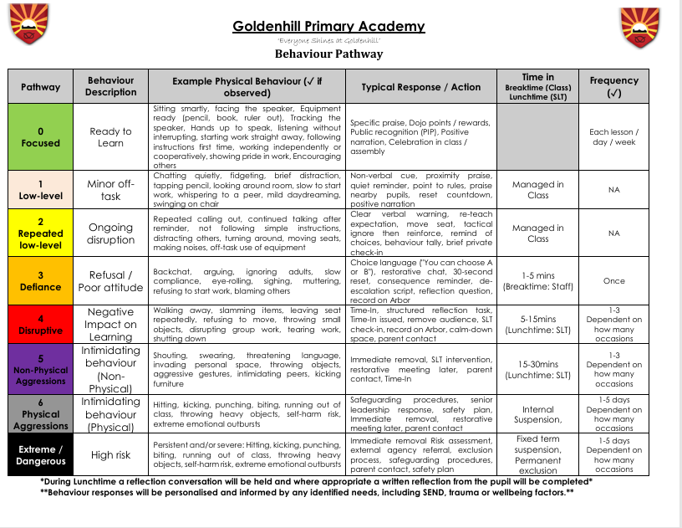

Slide 10
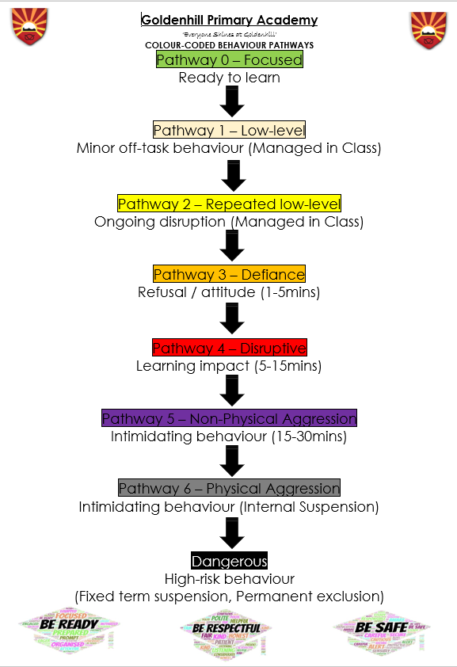

Slide 11

The Seven areas of the curriculum

Slide 12


Our topics

Slide 13
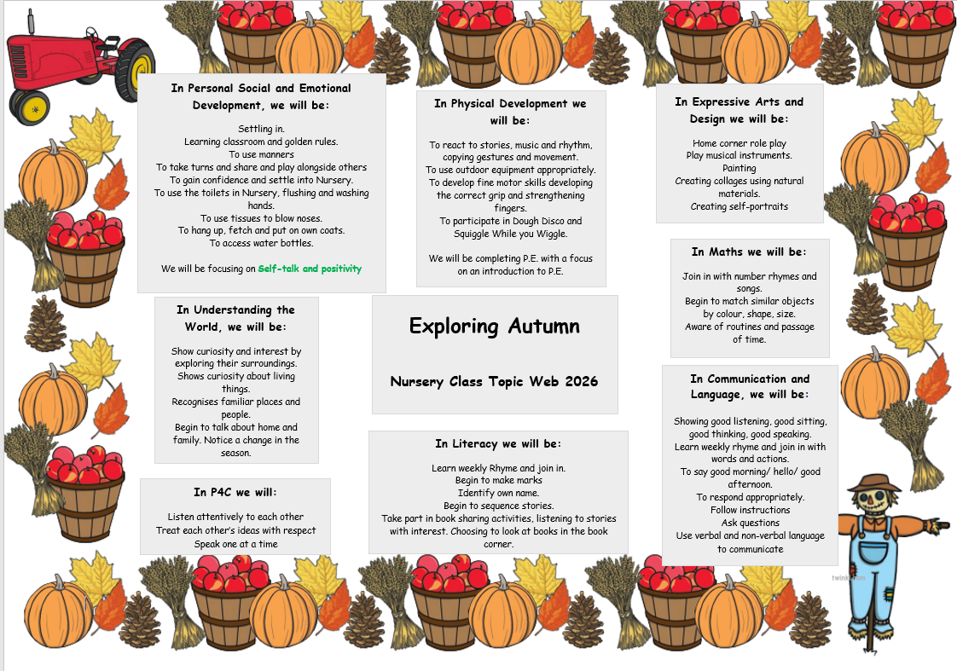

Slide 14
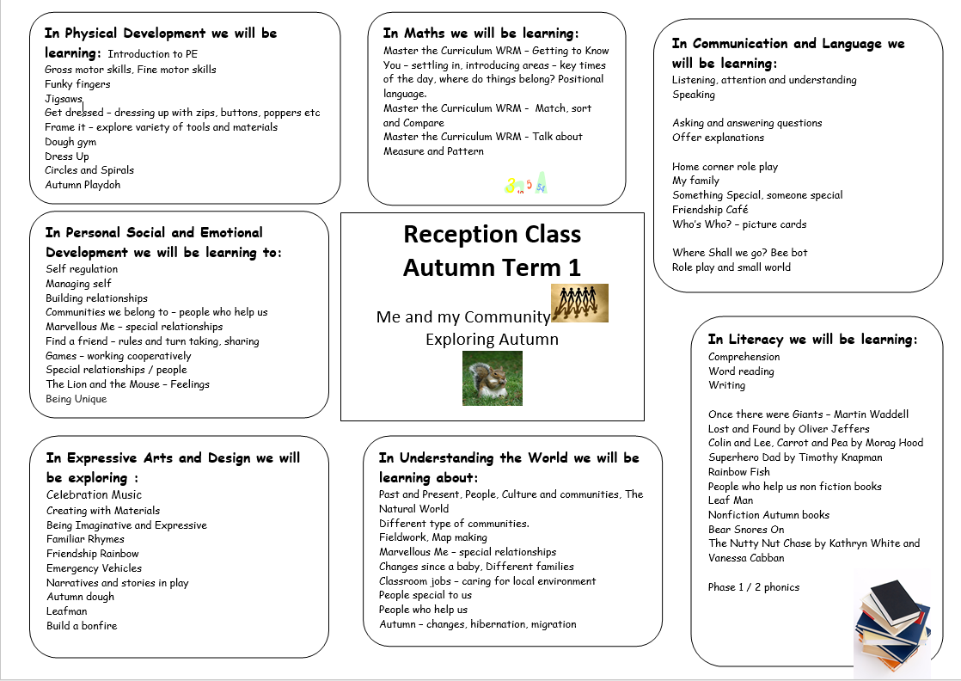

Slide 15
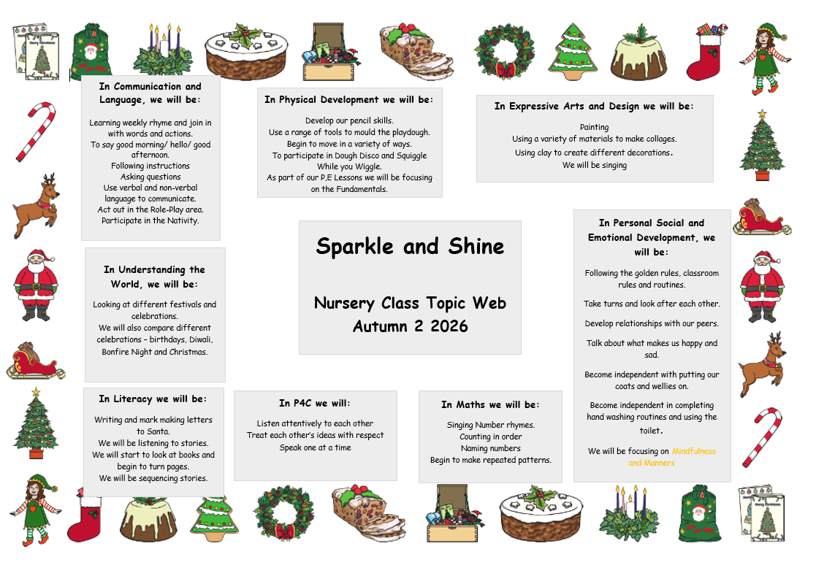

Slide 16
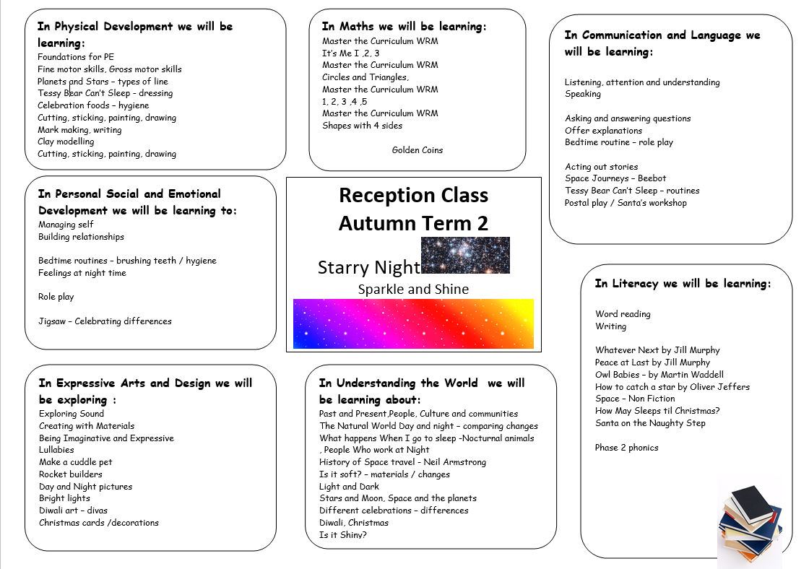

Slide 17


Slide 18
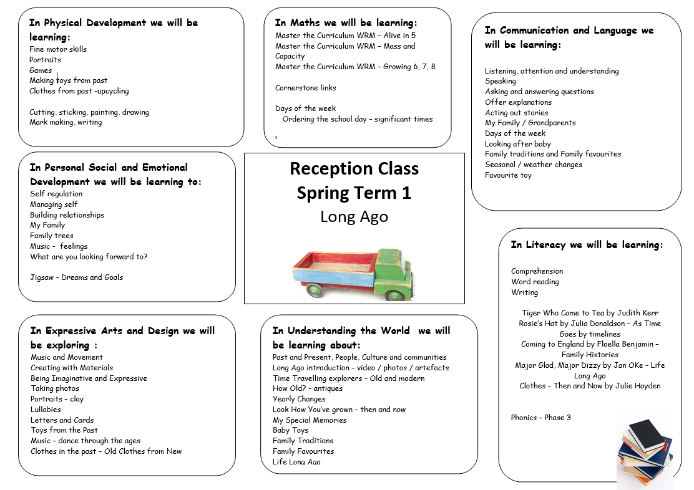

Slide 19


Slide 20
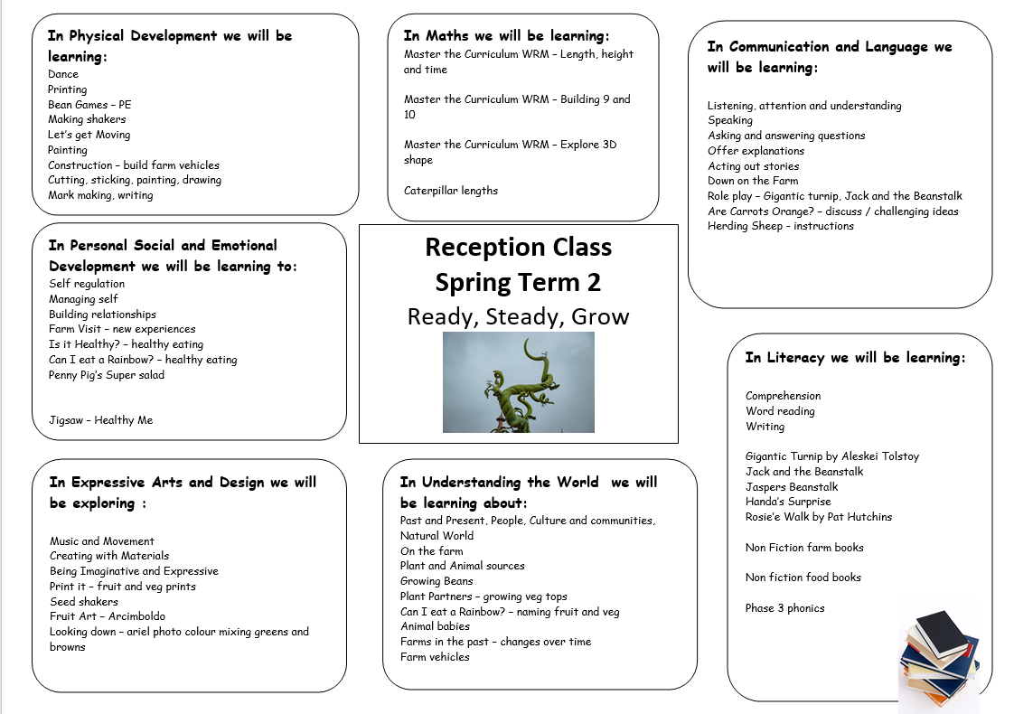

Slide 21


Slide 22
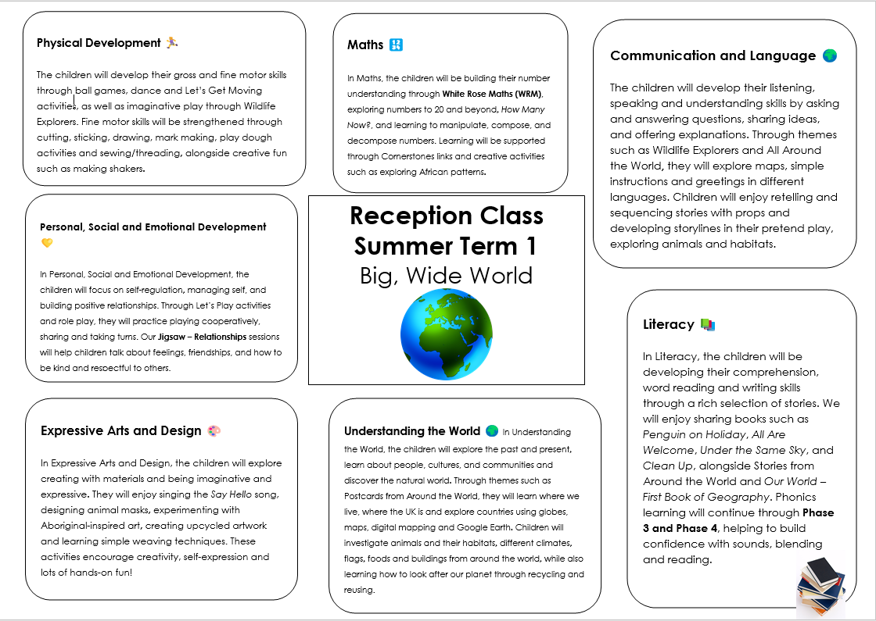

Slide 23


Slide 24
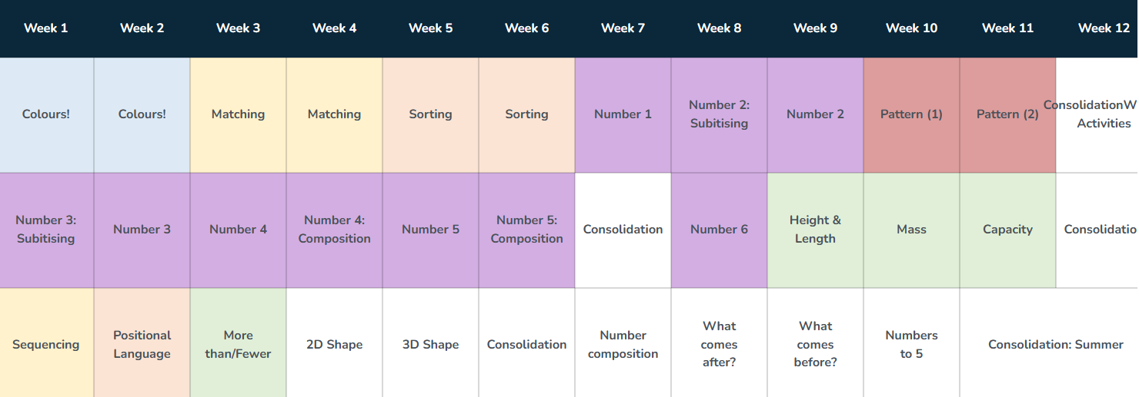
Numeracy focus

Slide 25
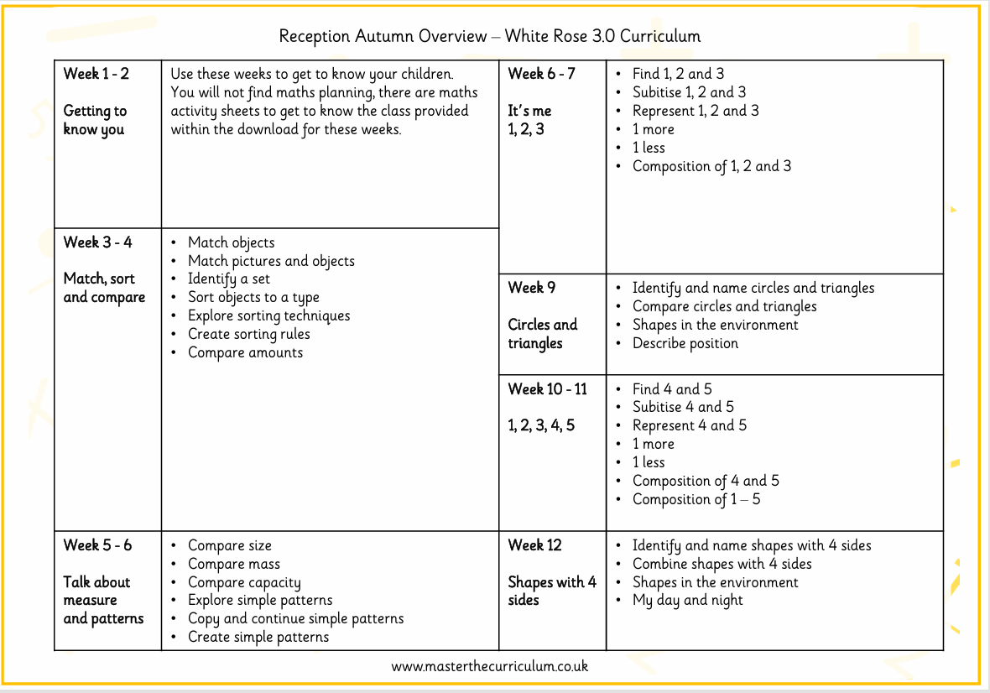

Slide 26
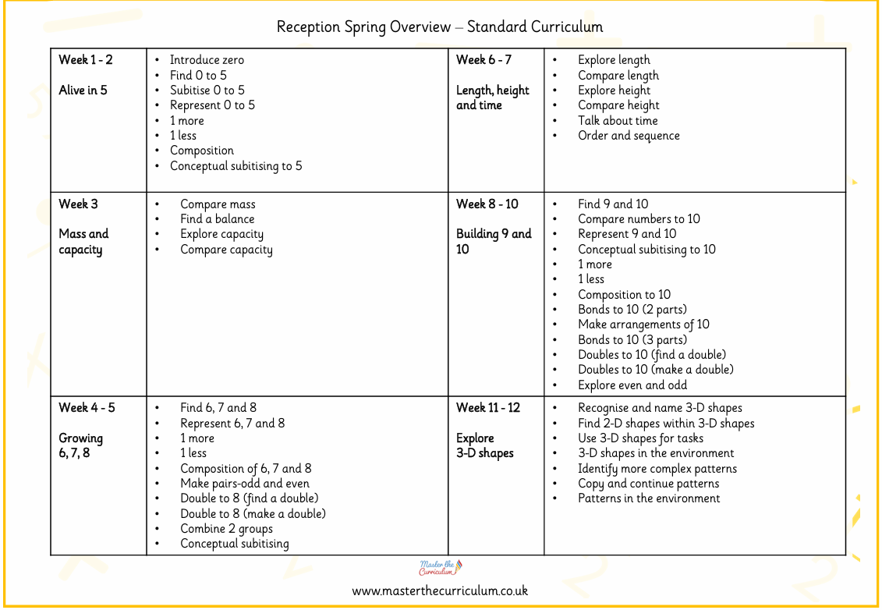

Slide 27
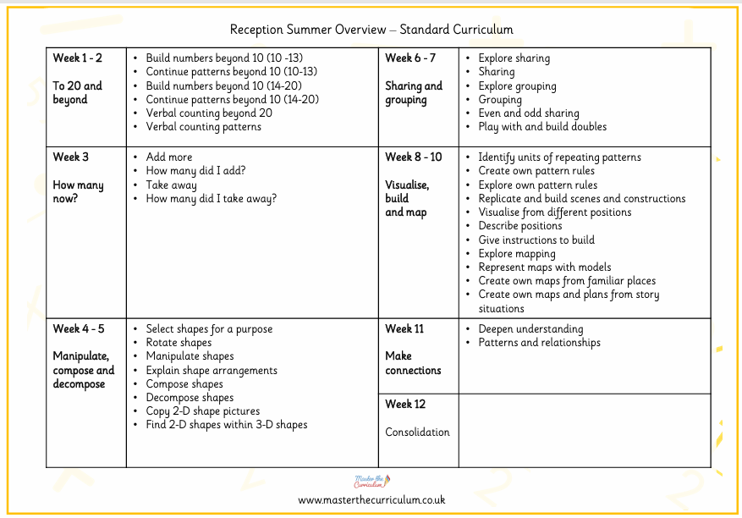

Slide 28
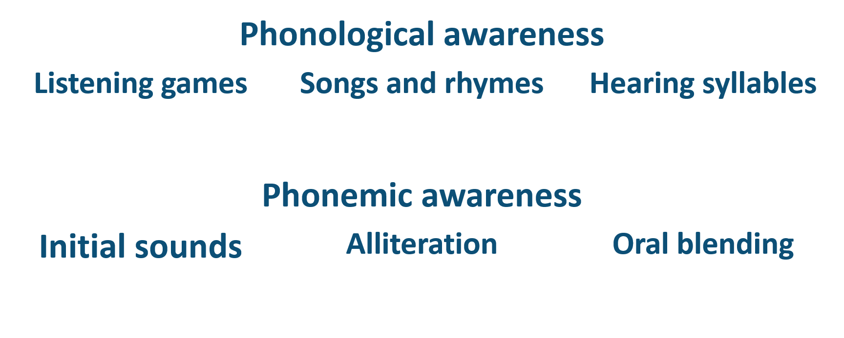
Little Wandle Foundations for Phonics

Slide 29
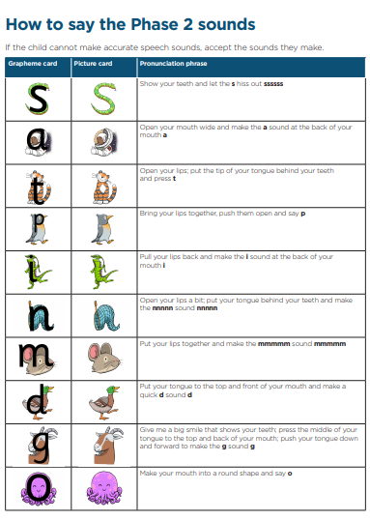
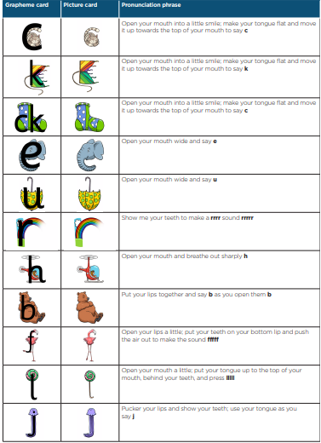
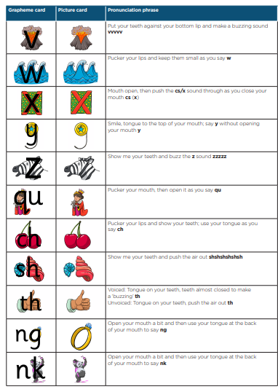


Slide 30
Class Dojo Portfolios.
These will be uploaded to twice a week to show a snapshot of what your child has been up to whilst in Early Years and will be a focus of the 7 areas.
Dojo will be used to showcase your children’s work at school, you can upload your own portfolio to show what you get up to at the weekends.
We will not reply to any messages via the Dojo app, so please if you have any urgent questions please either ask me at the gate before or after school, go to the office or give the school a call.

Slide 31
How you can help your child at home
Daily reading of their reading book and phonics sheets
Practising phonics and spellings sent home
Ensuring all homework is completed and returned on time / shared on Learning Book
Sharing books regularly to foster a love of stories
Counting and recognising numbers, coins, shapes, days of week, clock faces – new maths activities to come.
Please let us know when your child does something amazing at home – it could be swimming certificates, doing up their buttons for the first time, riding their bike without stabilisers, cutting their own food….etc, etc Your input is crucial in their learning journey and helps to give us a clear picture of your child.

Slide 32
Parents and Carers:
Please bring only essential items into school
Wellies are an essential part of our day.
Puddle suits so that we can enjoy the outdoors no matter the weather.
Water bottles
Uniform
Please ensure that any items which your child brings into school,
are clearly named and labelled.

Slide 33
Do you have any questions?

