Slide 1
WELCOME TO YEAR 5
Teachers:
Mrs Keay
Miss Dunn

Slide 2
We will discuss…
A typical week
Topics
Maths and Reading
Assessment
PE
Behaviour
Homework
Lunchtimes
How can you help?
Questions

Slide 3
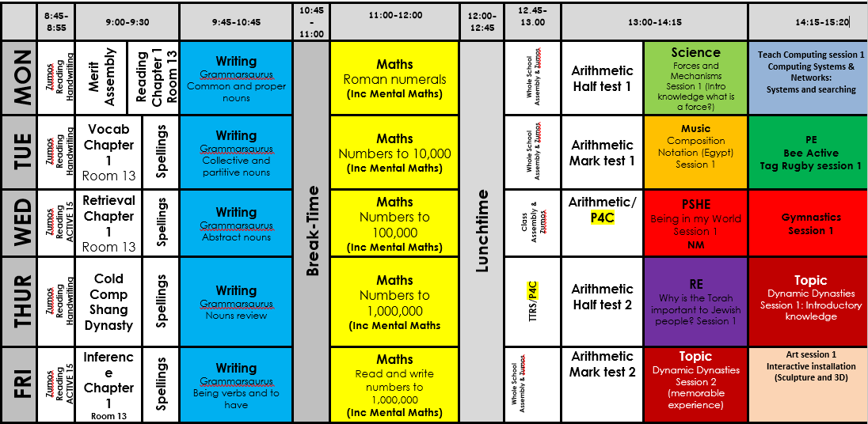
USUAL WEEKLY TIMETABLE

Slide 4
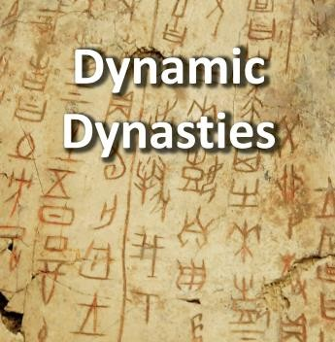
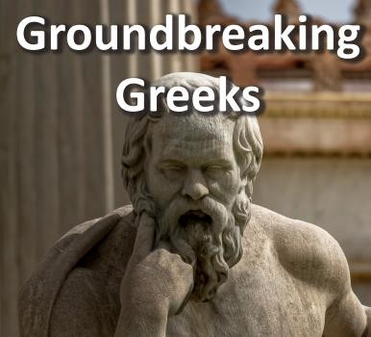
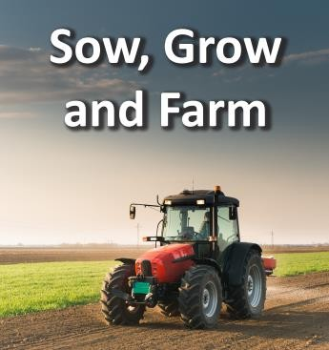
They will explore a timeline of the first five Chinese dynasties and learn about the legends surrounding the beginning of Chinese civilisation.They will take a deep dive into the history of the Bronze Age Shang Dynasty and explore evidence found in the ancient city of Yin.
In the Groundbreaking Greeks project, your child will learn about different periods of Greek history, exploring the earliest civilisations, the devastation of the Dark Age and the breakthroughs and developments of the Archaic and Classical periods.
In the Sow, Grow and Farm project, your child will learn about allotments in the United Kingdom and how the government encouraged people to have them to support food rationing during the Second World War.

Slide 5
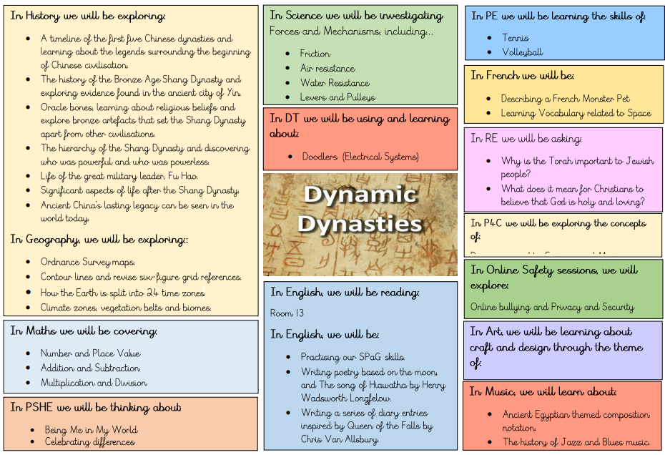
TOPIC WEB

Slide 6
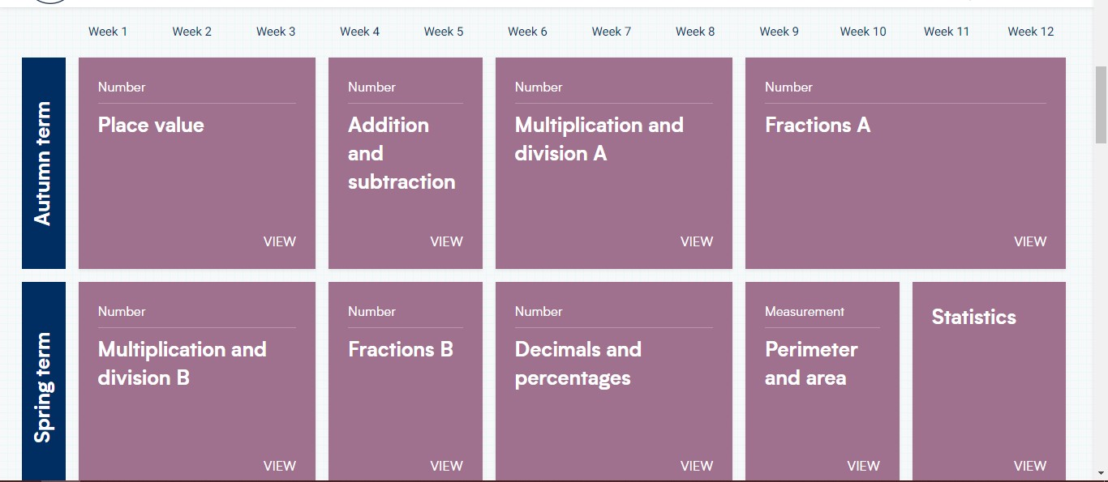
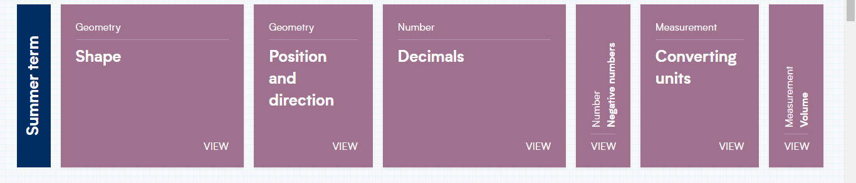
MATHS

Slide 7


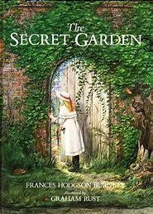
READING
Guided Reading (4 times a week)
Monday: Exploring the Chapter
Tuesday: Unpicking Key Vocabulary
Wednesday: Retrieval Skills Thursday: Inference Skills
Friday: Cold Comprehension
Accelerated Reader
Daily opportunities to read AR
Book
Daily access to AR quiz
Reading books must come back to school every day

Slide 8
READING
AR Test
Each book that a child reads gives access to a ‘test’, which is a
comprehension activity based on the book.
Each half term, children take a ‘star reading test’ based on the scores they have so far. This shows us their reading age and affects which books they bring home!
The results of these tests help to build up a bank of achievements which provide the evidence used to provide an accurate assessment of your child’s ability at the end of each half term.

Slide 9
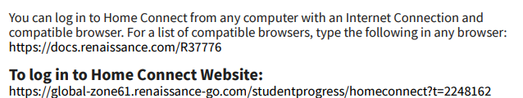
Home Connect
You will have received a personalised letter about AR Home connect.
If you log in, you will be notified of quizzes taken by your child in school and whether or not they passed. It is a good way to keep engaged with your child’s learning and encourage them to read at home.

Slide 10
ASSESSMENT AT GOLDENHILL
Assessment Data is taken at three points in the year.
Age Related Expectations (ARE)
(B) Below
(WT)
(EXP)
(HS)
Working Towards Expected Standard Higher Standard

Slide 11
WRITING IN YEAR 5: VOCABULARY, GRAMMAR AND PUNCTUATION
Year 5 objectives:
develop their understanding of the concepts set out in English appendix 2 by:
  recognising vocabulary and structures that are appropriate for formal speech and writing, including subjunctive forms
  using passive verbs to affect the presentation of information in a sentence
  using the perfect form of verbs to mark relationships of time and cause
  using expanded noun phrases to convey complicated information concisely
  using modal verbs or adverbs to indicate degrees of possibility
  using relative clauses beginning with who, which, where, when, whose, that or with an implied (ie omitted) relative pronoun
  learning the grammar for years 5 and 6 in English appendix 2
indicate grammatical and other features by:
  using commas to clarify meaning or avoid ambiguity in writing
  using hyphens to avoid ambiguity
  using brackets, dashes or commas to indicate parenthesis
  using semicolons, colons or dashes to mark boundaries between independent clauses
  using a colon to introduce a list
  punctuating bullet points consistently

Slide 12
WRITING IN YEAR 5: COMPOSITION
Year 5 objectives:
plan their writing by:
  identifying the audience for and purpose of the writing, selecting the appropriate form and using other similar writing as models for their own
  noting and developing initial ideas, drawing on reading and research where necessary
  in writing narratives, considering how authors have developed characters and settings in what pupils have read, listened to or seen performed
draft and write by:
  selecting appropriate grammar and vocabulary, understanding how such choices can change and enhance meaning
  in narratives, describing settings, characters and atmosphere and integrating dialogue to convey character and advance the action
  précising longer passages
  using a wide range of devices to build cohesion within and across paragraphs
  using further organisational and presentational devices to structure text and to guide the reader [for example, headings, bullet points, underlining]
evaluate and edit by:
  assessing the effectiveness of their own and others’ writing
  proposing changes to vocabulary, grammar and punctuation to enhance effects and clarify meaning
  ensuring the consistent and correct use of tense throughout a piece of writing
  ensuring correct subject and verb agreement when using singular and plural, distinguishing between the language of speech and writing and choosing the appropriate register
proofread for spelling and punctuation errors
perform their own compositions, using appropriate intonation, volume, and movement so that meaning is clear

Slide 13
WRITING IN YEAR 5: SPELLING
Year 5 objectives:
use further prefixes and suffixes and understand the guidance for adding them
spell some words with ‘silent’ letters [for example, knight, psalm, solemn]
continue to distinguish between homophones and other words which are often confused
use knowledge of morphology and etymology in spelling and understand that the spelling of some words needs to be learnt specifically, as listed in English appendix 1
use dictionaries to check the spelling and meaning of words
use the first 3 or 4 letters of a word to check spelling, meaning or both of these in a dictionary
use a thesaurus

Slide 14
WRITING IN YEAR 5: HANDWRITING
Year 5 objectives:
write legibly, fluently and with increasing speed by:
  choosing which shape of a letter to use when given choices and deciding whether or not to join
specific letters
  choosing the writing implement that is best suited for a task

Slide 15
READING IN YEAR 5: COMPREHENSION
maintain positive attitudes to reading and an understanding of what they read by:
  continuing to read and discuss an increasingly wide range of fiction, poetry, plays, non-fiction and reference books or textbooks
  reading books that are structured in different ways and reading for a range of purposes
  increasing their familiarity with a wide range of books, including myths, legends and traditional stories, modern fiction, fiction from our literary heritage, and books from other cultures and traditions
  recommending books that they have read to their peers, giving reasons for their choices
  identifying and discussing themes and conventions in and across a wide range of writing
  making comparisons within and across books
  learning a wider range of poetry by heart
  preparing poems and plays to read aloud and to perform, showing understanding through intonation, tone and volume so that the meaning is clear to an audience
understand what they read by:
  checking that the book makes sense to them, discussing their understanding and exploring the meaning of words in context
  asking questions to improve their understanding
  drawing inferences such as inferring characters’ feelings, thoughts and motives from their actions, and justifying inferences with evidence
  predicting what might happen from details stated and implied
  summarising the main ideas drawn from more than 1 paragraph, identifying key details that support the main ideas
  identifying how language, structure and presentation contribute to meaning
discuss and evaluate how authors use language, including figurative language, considering the impact on the reader
distinguish between statements of fact and opinion

Slide 16
MATHS: NUMBER
.
Year 5 objectives:
read, write, order and compare numbers to at least 1,000,000 and determine the value of each digit
count forwards or backwards in steps of powers of 10 for any given number up to 1,000,000
interpret negative numbers in context, count forwards and backwards with positive and negative whole numbers,
including through 0
- round any number up to 1,000,000 to the nearest 10, 100, 1,000, 10,000 and 100,000
solve number problems and practical problems that involve all of the above
read Roman numerals to 1,000 (M) and recognize years written in Roman numerals

Slide 17
MATHS: KEY VOCABULARY AND SKILLS –
ADDITION, SUBTRACTION, MULTIPLICATION
AND DIVISION
Year 5 Objectives :
add and subtract whole numbers with more than 4 digits, including using formal written methods (columnar addition and subtraction)
add and subtract numbers mentally with increasingly large numbers
use rounding to check answers to calculations and determine, in the context of a problem, levels of accuracy
solve addition and subtraction multi-step problems in contexts, deciding which operations and methods to use and why
identify multiples and factors, including finding all factor pairs of a number, and common factors of 2 numbers
know and use the vocabulary of prime numbers, prime factors and composite (non-prime) numbers
establish whether a number up to 100 is prime and recall prime numbers up to 19
multiply numbers up to 4 digits by a one- or two-digit number using a formal written method, including long multiplication for two-digit numbers
multiply and divide numbers mentally, drawing upon known facts
divide numbers up to 4 digits by a one-digit number using the formal written method of short division and interpret remainders appropriately for the context
multiply and divide whole numbers and those involving decimals by 10, 100 and 1,000
recognise and use square numbers and cube numbers, and the notation for squared (²) and cubed (³)
solve problems involving multiplication and division, including using their knowledge of factors and multiples, squares and cubes

Slide 18
MATHS: FRACTIONS
Year 5 objectives:
-compare and order fractions whose denominators are all multiples of the same number
identify, name and write equivalent fractions of a given fraction, represented visually, including tenths and hundredths
recognise mixed numbers and improper fractions and convert from one form to the other and write mathematical statements > 1 as a mixed
Number.
add and subtract fractions with the same denominator, and denominators that are multiples of the same number
multiply proper fractions and mixed numbers by whole numbers, supported by materials and diagrams
read and write decimal numbers as fractions.
recognise and use thousandths and relate them to tenths, hundredths and decimal equivalents
round decimals with 2 decimal places to the nearest whole number and to 1 decimal place
read, write, order and compare numbers with up to 3 decimal places
solve problems involving number up to 3 decimal places
recognise the per cent symbol (%) and understand that per cent relates to ‘number of parts per 100’, and write percentages as a fraction with denominator 100, and as a decimal fraction.

Slide 19
MATHS: MEASUREMENT
Year 5 objectives:
convert between different units of metric measure [for example, kilometre and metre; centimetre and metre; centimetre and millimetre; gram and kilogram; litre and millilitre]
understand and use approximate equivalences between metric units and common imperial units such as inches, pounds and pints
measure and calculate the perimeter of composite rectilinear shapes in centimetres and metres
calculate and compare the area of rectangles (including squares), including using standard units, square centimetres (cm²) and square metres (m²), and estimate the area of irregular shapes
estimate volume [for example, using 1 cm³ blocks to build cuboids (including cubes)] and capacity [for example, using water]
solve problems involving converting between units of time
use all four operations to solve problems involving measure [for example, length, mass, volume, money] using decimal notation, including scaling

Slide 20
MATHS: GEOMETRY
Year 5 objectives:
identify 3-D shapes, including cubes and other cuboids, from 2-D representations
know angles are measured in degrees: estimate and compare acute, obtuse and reflex angles
draw given angles, and measure them in degrees (°)
identify:
angles at a point and 1 whole turn (total 360°)
angles at a point on a straight line and half a turn (total 180°) other multiples of 90°
use the properties of rectangles to deduce related facts and find missing lengths and angles
distinguish between regular and irregular polygons based on reasoning about equal sides and angle
- identify, describe and represent the position of a shape following a reflection or translation, using the appropriate language, and know that the shape has not changed

Slide 21
MATHS: STATISTICS
Year 5 objectives:
-solve comparison, sum and difference problems using information presented in a line graph complete, read and interpret information in tables, including timetables

Slide 22
Science
Working scientifically
Children will be…
planning different types of scientific enquiries to answer questions, including recognising and controlling variables where necessary
taking measurements, using a range of scientific equipment, with increasing accuracy and precision, taking repeat readings when appropriate
recording data and results of increasing complexity using scientific diagrams and labels, classification keys, tables, scatter graphs, bar and line graphs
using test results to make predictions to set up further comparative and fair tests
reporting and presenting findings from enquiries, including conclusions, causal relationships and explanations of and degree of trust in results, in oral and written forms such as displays and other presentations
identifying scientific evidence that has been used to support or refute ideas or arguments

Slide 23
Science
Living things and their habitats
describe the life process of reproduction in some plants and animals
Animals, including humans
describe the changes as humans develop to old age
Properties and changes of materials
compare and group together everyday materials on the basis of their properties, including their hardness, solubility, transparency, conductivity (electrical and thermal), and response to magnets
know that some materials will dissolve in liquid to form a solution, and describe how to recover a substance from a solution
use knowledge of solids, liquids and gases to decide how mixtures might be separated, including through filtering, sieving and evaporating
give reasons, based on evidence from comparative and fair tests, for the particular uses of everyday materials, including metals, wood and plastic
demonstrate that dissolving, mixing and changes of state are reversible changes

Slide 24
Science
Earth and space
describe the Sun, Earth and Moon as approximately spherical bodies
use the idea of the Earth’s rotation to explain day and night and the apparent movement of the sun across the sky
Forces
explain that unsupported objects fall towards the Earth because of the force of gravity acting between the Earth and the falling object
identify the effects of air resistance, water resistance and friction, that act between moving surfaces
recognise that some mechanisms, including levers, pulleys and gears, allow a smaller force to have a greater effect

Slide 25
BEHAVIOUR
Dojo’s:These can be given by any member of staff and reward any type of good behaviour or effort.The children have an electronic character which they can add their dojo’s to.Top Dojo winner gets a certificate each week.
Children will build up their dojos to spend in the ‘Dojo shop’.
Marble jar: This is a whole class reward system where they work together as a team to gain marbles
Pupils who do not demonstrate acceptable or appropriate behavior will be monitored through
the In Class System:
Warning.
2. Second warning.
3.Third warning: move to orange on the behaviour chart.
4. Fourth warning: move to red on the behaviour chart and behaviour point issued.
5. Fifth warning another behaviour point is issued.The pupil will be asked to take some ‘time out’ in another classroom. If the child, following their return to the class setting, continued to demonstrate inappropriate behaviour, a member of SLT will be called to remove the child
from the class to have ‘time out’ with them.

Slide 26
HOMEWORK:
Weekly Expectations
Reading (at least 4 times a week)
Times tables (daily using TTRS)
2 set pieces of homework, which may include:
English activities
Maths activities
Topic activities- research and creative activities (you may be given up to 2 weeks to complete these).
Homework will be given out on a Friday and will be due in the following Wednesday.

Slide 27
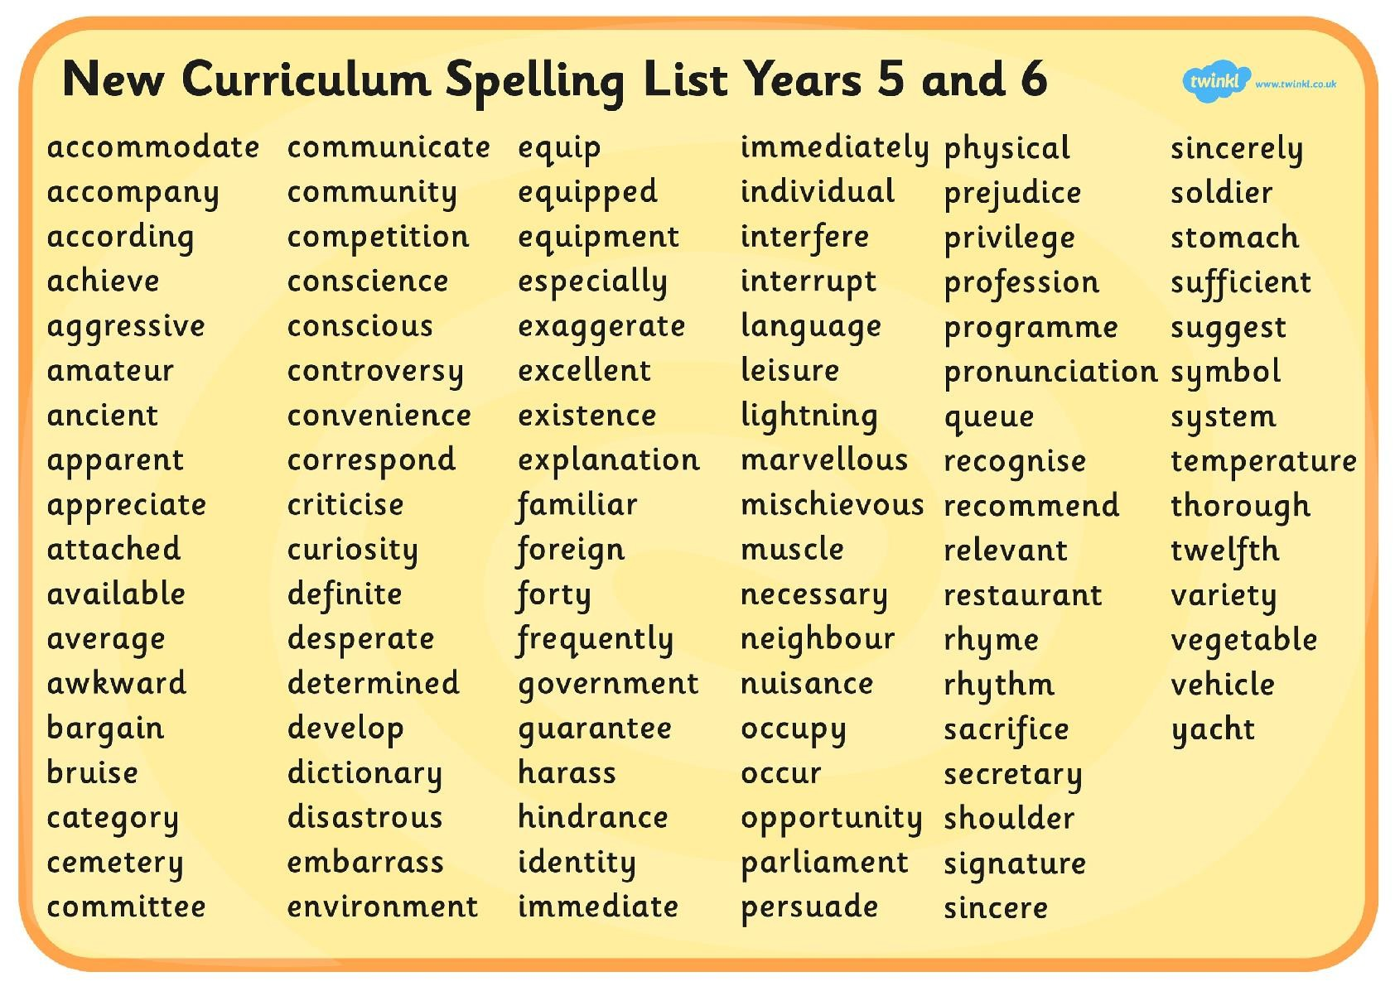

Slide 28
HOW CAN YOU HELP?
Handwriting practise
Encouraging good presentation e.g. Homework
Reading at home
Times table practise
Spelling practise

