Slide 1
Reading Comprehension
6/1/26

Slide 2
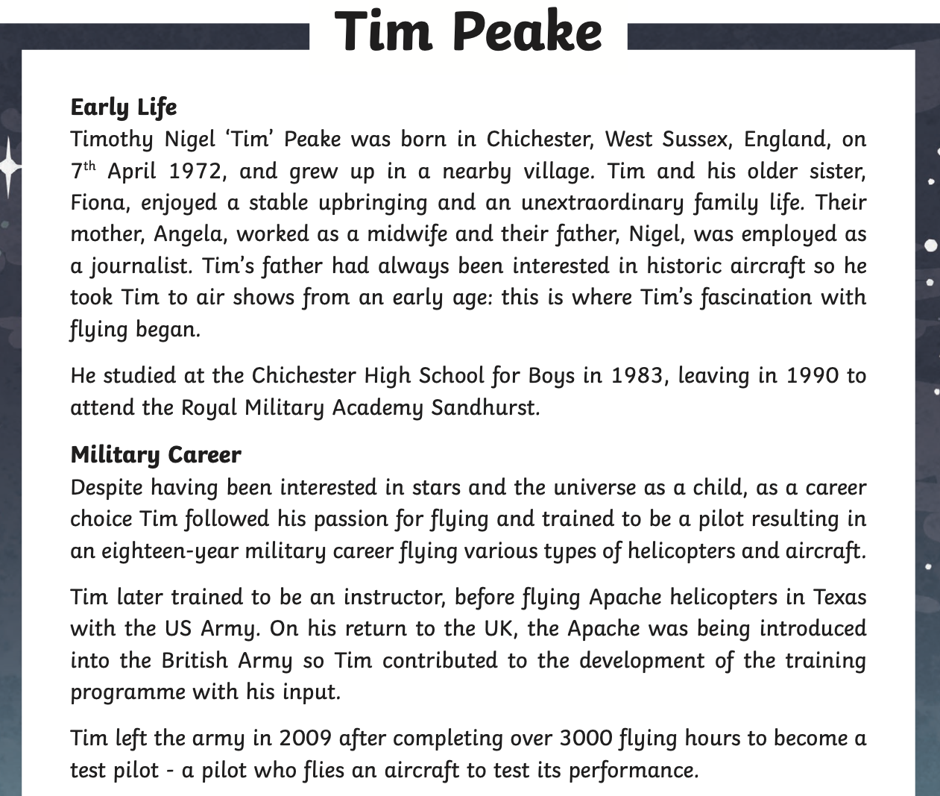
Read the text about Tim Peake then answer the questions.

Slide 3
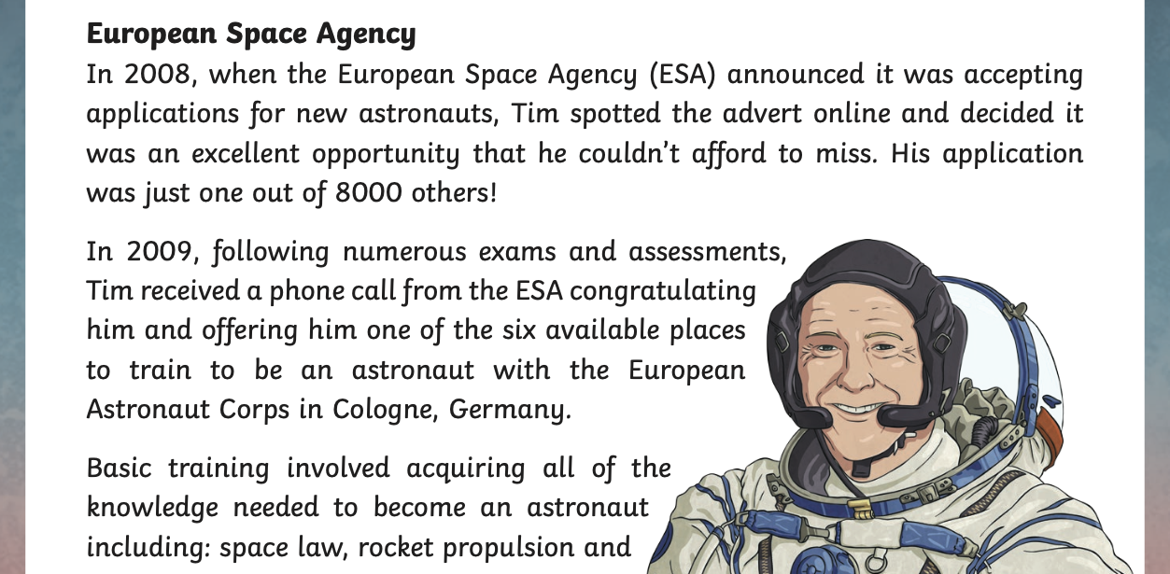

Slide 4
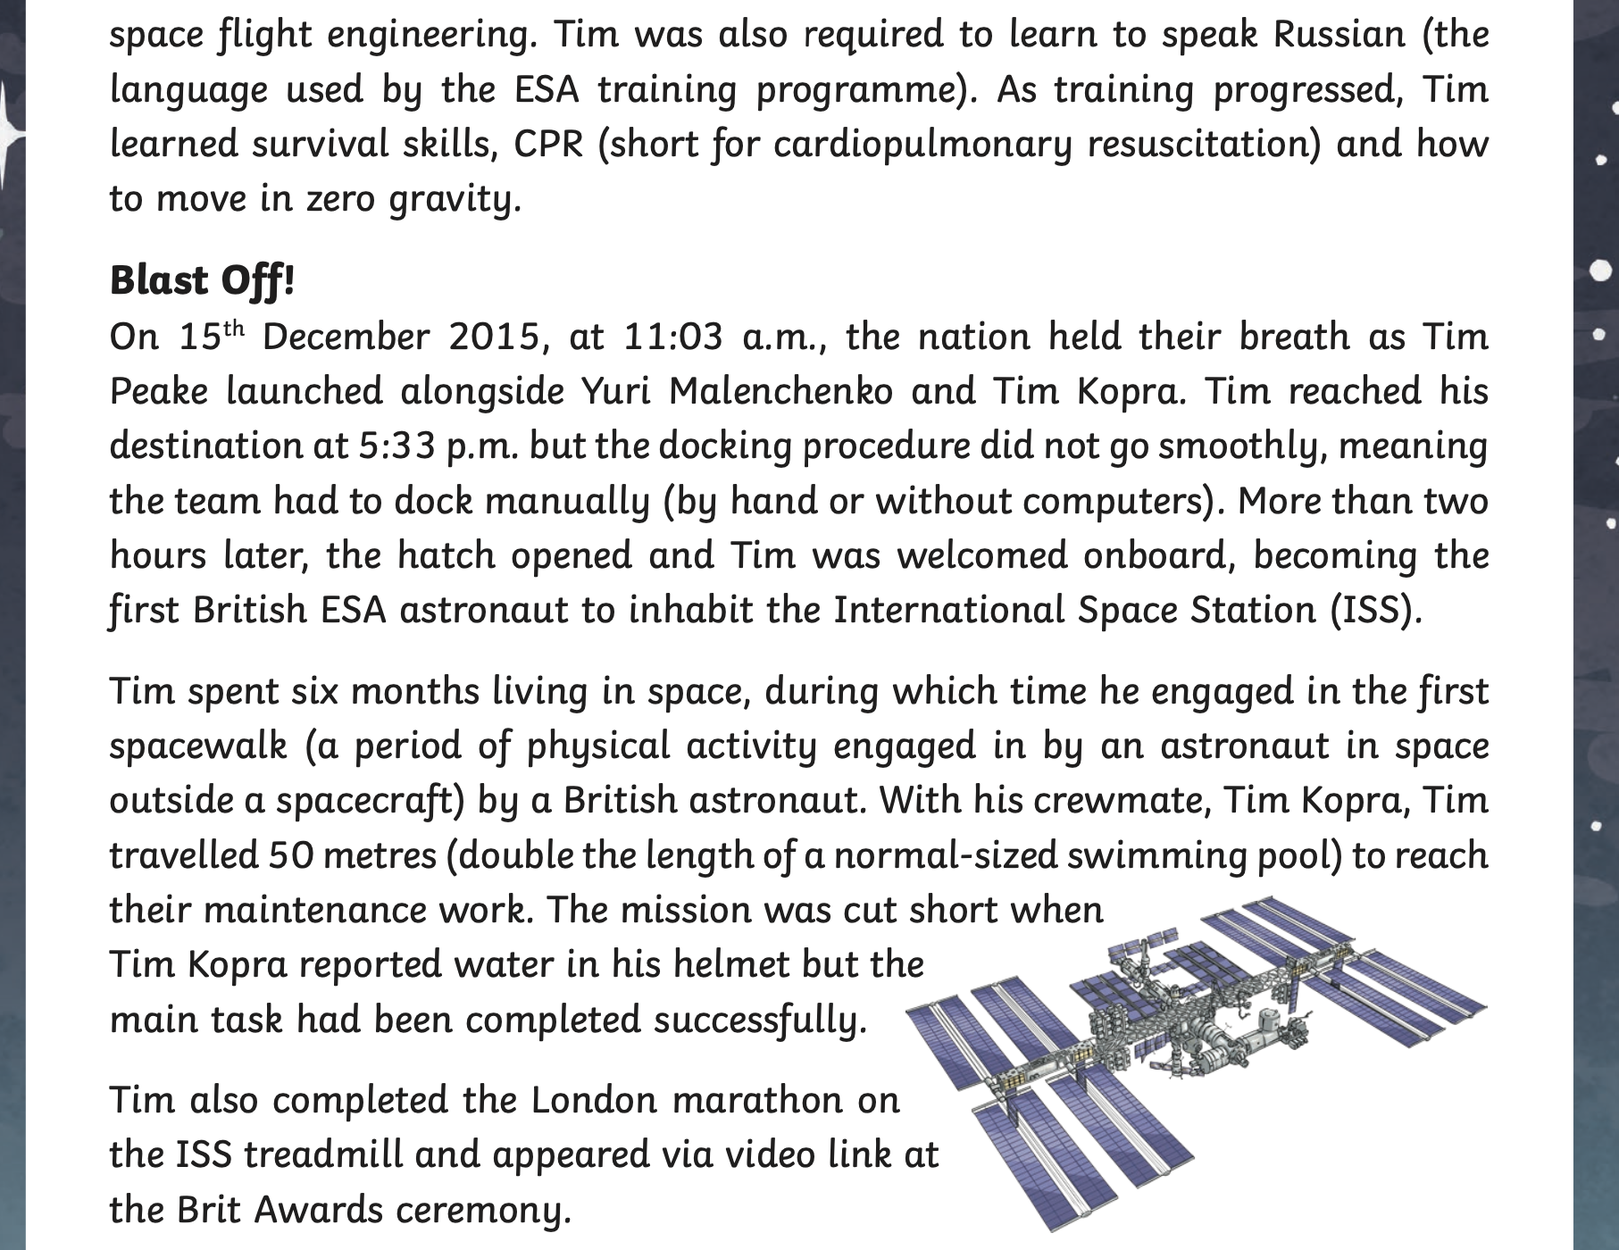

Slide 5
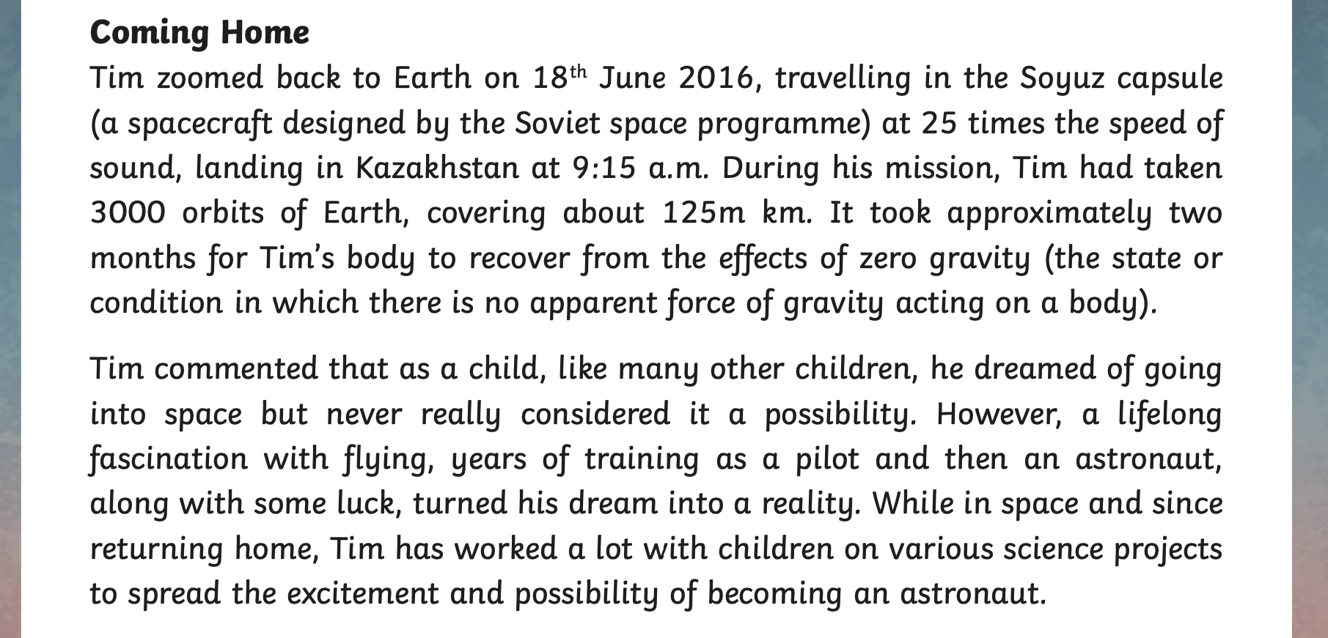

Slide 6
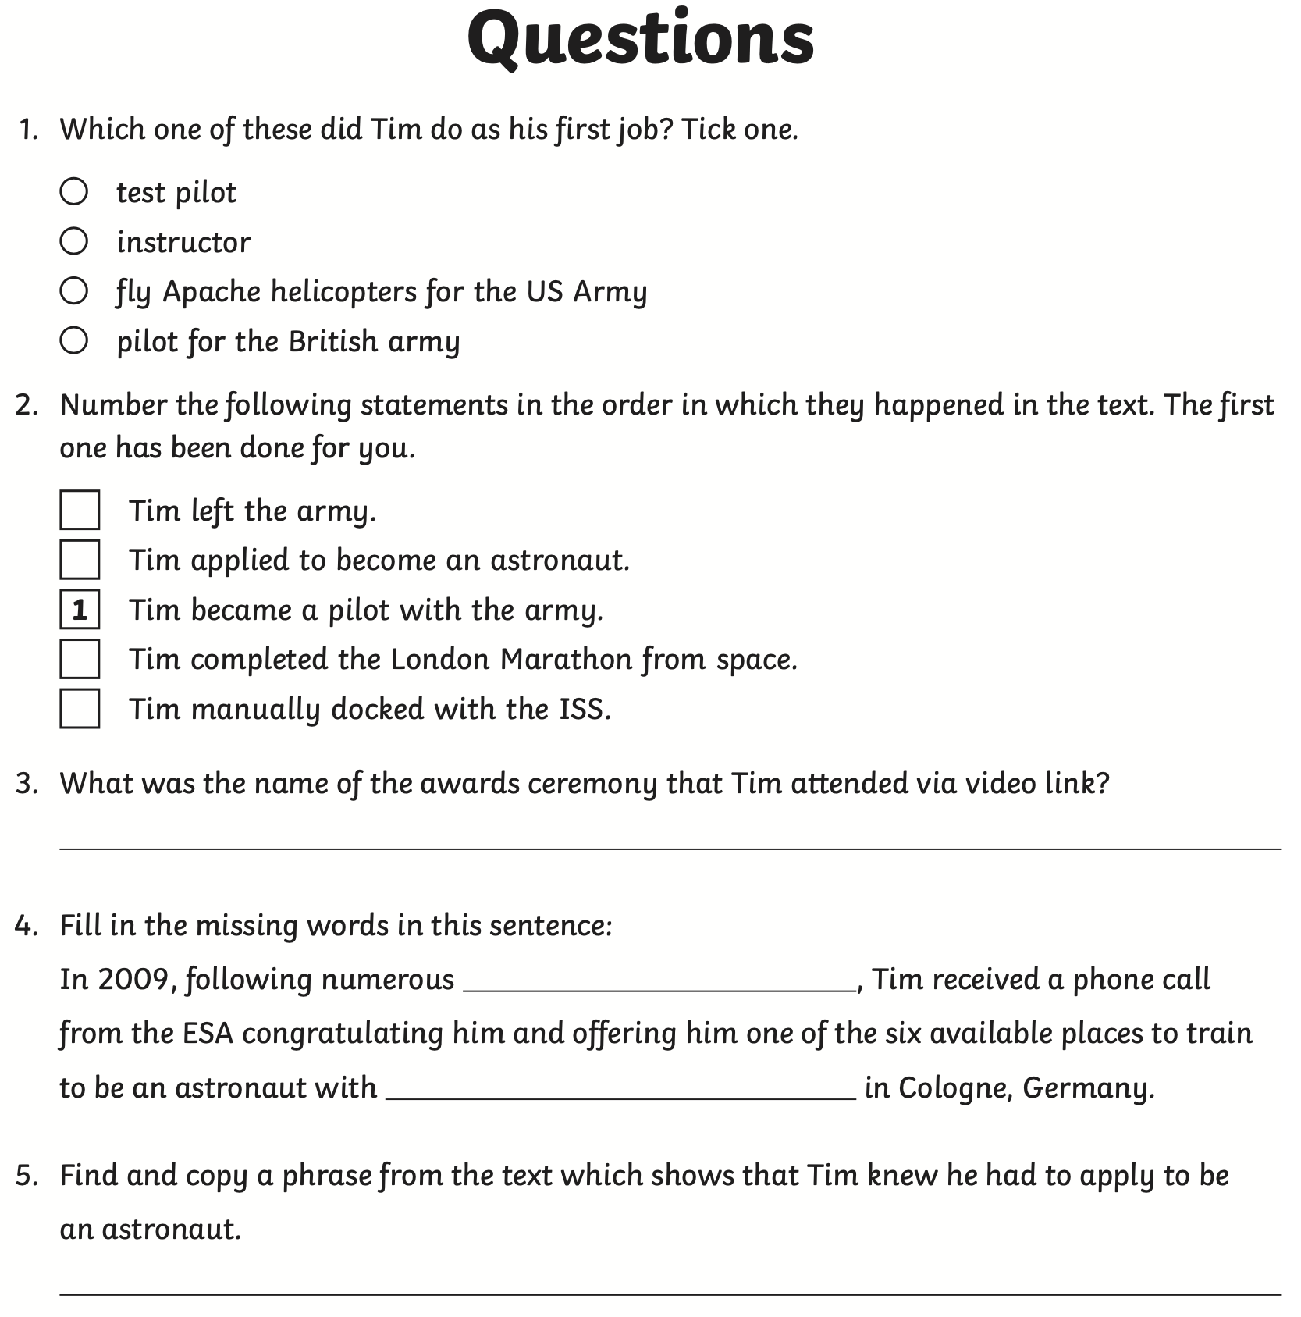
Questions- Answer these in your book.

Slide 7

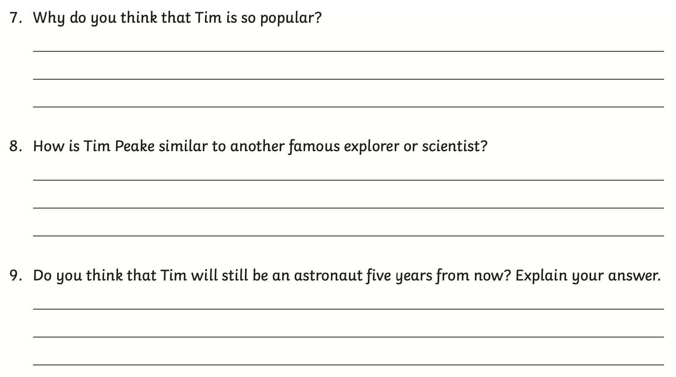

Slide 8
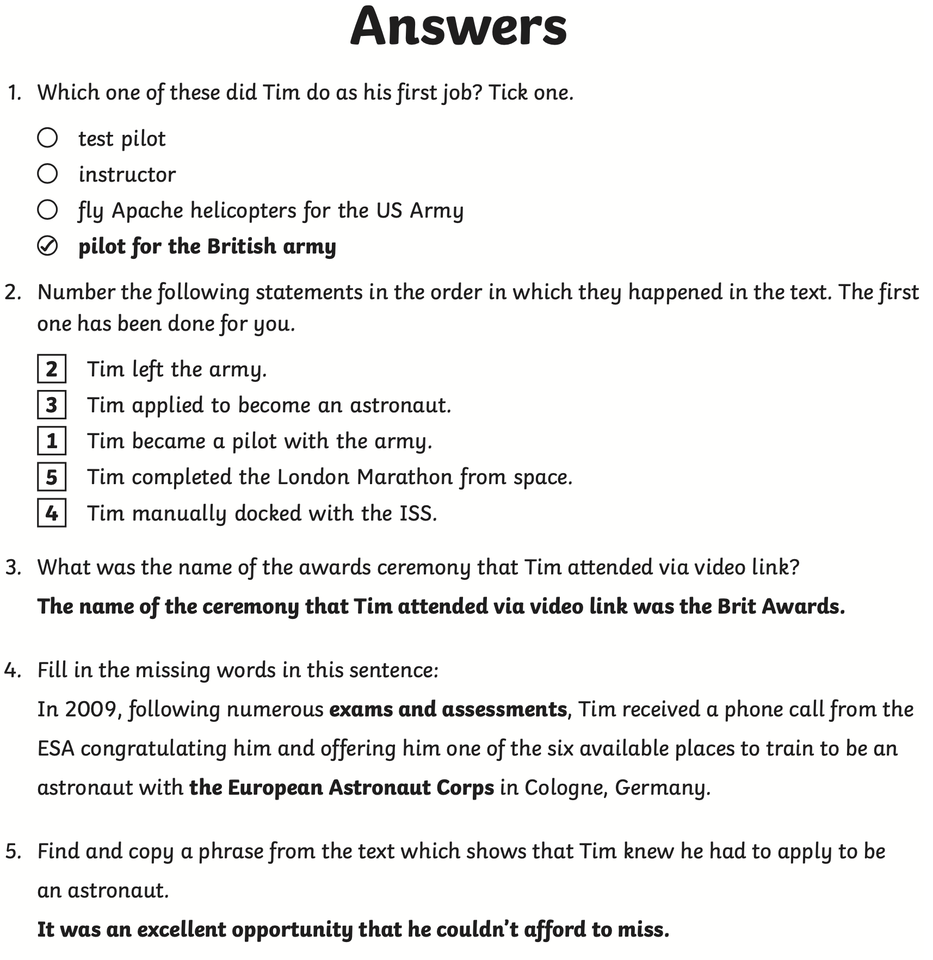
Answers.
Try to mark your work in a different pen like we do in school, add to them if you need to.

Slide 9



