Slide 1

Welcome
Information Presentation for Reception parents
Staff:
Class Teacher: Miss Sutherland
Miss Glover
Mrs Martin

Slide 2
Today, we will discuss:
The EYFS curriculum
General life in Reception
Phonics
Reading
Assessment
Behaviour Management
Topics in Reception
Donations

Slide 3
The EYFS Curriculum
The Early Years Foundation Stage curriculum is split into 7 areas of learning and within these 7 areas there are 17 goals against which the children are assessed.
Personal, Social and Emotional Development
Communication and Language
Physical Development
Literacy
Mathematics
Understanding the World
Expressive Arts and Design

Slide 4
Personal, Social and Emotional Development
This area of learning is a prime area. It is split into 3 goals.
Self Regulation
Show an understanding of their own feelings and those of others and begin to regulate their behaviour accordingly.
• Set and work towards simple goals, being able to wait for what they want and control their immediate impulses when appropriate.
• Give focused attention to what the teacher says, responding appropriately even when engaged in activity, and show an ability to follow instructions involving several ideas or actions.
Managing Self
• Be confident to try new activities and show independence, resilience and perseverance in the face of challenge.
• Explain the reasons for rules, know right from wrong and try to behave accordingly.
• Manage their own basic hygiene and personal needs, including dressing, going to the toilet and understanding the importance of healthy food choices
Building Relationships
Work and play cooperatively and take turns with others.
• Form positive attachments to adults and friendships with peers.
• Show sensitivity to their own and to others’ needs

Slide 5
Communication and Language
This area of learning is a prime area and underpins all learning across the curriculum. It is split into 2 goals.
Listening Attention and Understanding
• Listen attentively and respond to what they hear with relevant questions, comments and actions when being read to and during whole class discussions and small group interactions.
• Make comments about what they have heard and ask questions to clarify their understanding.
• Hold conversation when engaged in back-and-forth exchanges with their teacher and peers
Speaking
Participate in small group, class and one-to-one discussions, offering their own ideas, using recently introduced vocabulary.
• Offer explanations for why things might happen, making use of recently introduced vocabulary from stories, nonfiction, rhymes and poems when appropriate.
• Express their ideas and feelings about their experiences using full sentences, including use of past, present and future tenses and making use of conjunctions, with modelling and support from their teacher.

Slide 6
Physical Development
This area of learning is a prime area. It is split into 2 goals.
Gross Motor Skills
• Negotiate space and obstacles safely, with consideration for themselves and others.
• Demonstrate strength, balance and coordination when playing.
• Move energetically, such as running, jumping, dancing, hopping, skipping and climbing
Fine Motor Skills
• Hold a pencil effectively in preparation for fluent writing – using the tripod grip in almost all cases.
• Use a range of small tools, including scissors, paintbrushes and cutlery.
• Begin to show accuracy and care when drawing.

Slide 7
Literacy
This area of learning is a specific area. It is split into 3 goals.
Comprehension
Demonstrate understanding of what has been read to them by retelling stories and narratives using their own words and recently introduced vocabulary.
• Anticipate (where appropriate) key events in stories.
• Use and understand recently introduced vocabulary during discussions about stories, non fiction, rhymes and poems and during role play
Word Reading
Say a sound for each letter in the alphabet and at least 10 digraphs.
• Read words consistent with their phonic knowledge by sound-blending.
• Read aloud simple sentences and books that are consistent with their phonic knowledge, including some common exception words
Writing
Write recognisable letters, most of which are correctly formed.
• Spell words by identifying sounds in them and representing the sounds with a letter or letters.
• Write simple phrases and sentences that can be read by others.

Slide 8
Mathematics
This area of learning is a specific area. It is split into 2 goals.
Number
Have a deep understanding of number to 10, including the composition of each number.
• Subitise (recognise quantities without counting) up to 5.
• Automatically recall (without reference to rhymes, counting or other aids) number bonds up to 5 (including subtraction facts) and some number bonds to 10, including double facts
Numerical Patterns
Verbally count beyond 20, recognising the pattern of the
counting system.
• Compare quantities up to 10 in different contexts,
recognising when one quantity is greater than, less than or
the same as the other quantity.
• Explore and represent patterns within numbers up to 10,
including evens and odds, double facts and how quantities
can be distributed equally

Slide 9
Understanding The World
This area of learning is a specific area. It is split into 3 goals.
Past and Present
• Talk about the lives of the people around them and their roles in society.
• Know some similarities and differences between things in the past and now, drawing on their experiences and what has been read in class.
• Understand the past through settings, characters and events encountered in books read in class and storytelling.
People, Culture and Communities
• Describe their immediate environment using knowledge from observation, discussion, stories, non-fiction texts and maps. • Know some similarities and differences between different religious and cultural communities in this country, drawing on their experiences and what has been read in class.
• Explain some similarities and differences between life in this country and life in other countries, drawing on knowledge from stories, non-fiction texts and (when appropriate) maps
The Natural World
Explore the natural world around them, making observations and drawing pictures of animals and plants.
• Know some similarities and differences between the natural world around them and contrasting environments, drawing on their experiences and what has been read in class.
• Understand some important processes and changes in the natural world around them, including the seasons and changing states of matter

Slide 10
Expressive Arts and Design
This area of learning is a specific area. It is split into 2 goals.
Creating With Materials
Safely use and explore a variety of materials, tools and techniques, experimenting with colour, design, texture, form and function.
• Share their creations, explaining the process they have used.
• Make use of props and materials when role playing characters in narratives and stories
Being Imaginative and Expressive
• Invent, adapt and recount narratives and stories with peers and their teacher.
• Sing a range of well-known nursery rhymes and songs.
• Perform songs, rhymes, poems and stories with others, and (when appropriate) try to move in time with music

Slide 11
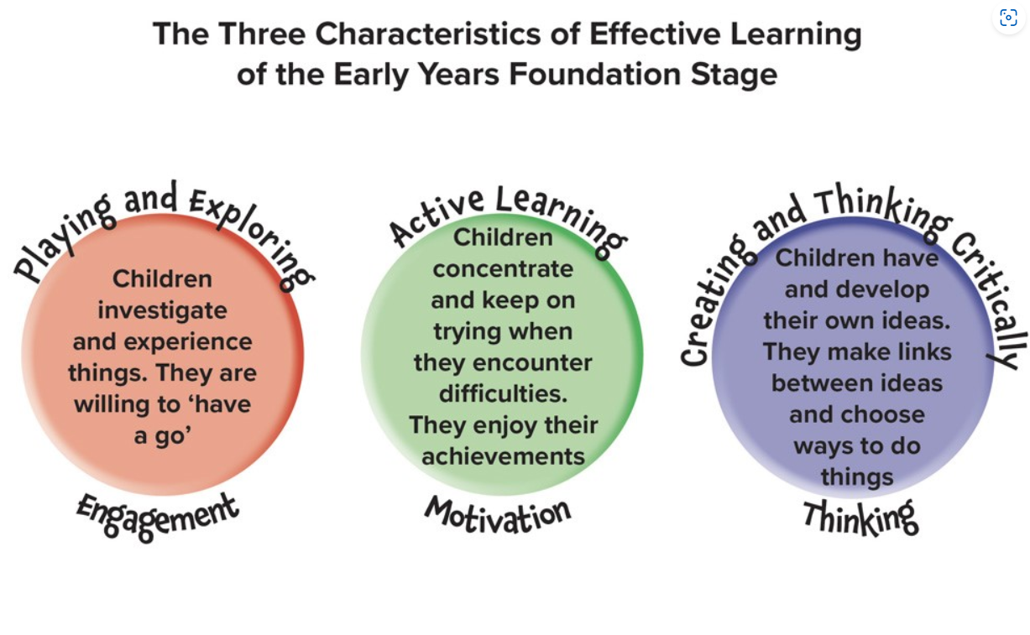
Characteristics of Effective learning

Slide 12
A typical week
During the week, all 7 areas of the curriculum are delivered in taught sessions, small group focussed work and in child choice activities.
A typical day:
Doors open at 8.45 where children are greeted at the gate.
The children will put away their belongings in their locker then sit at a table for a few minutes to complete a morning task- e.g. tracking, fine motor control, name writing, handwriting.
9.00- registration including days of the week.
9.05- Literacy or Mathematics lesson (Whole class carpet input followed by an adult focussed task along (including guided reading with other activities to address the learning objectives).
10.30-Outside playtime.
11.00-Phonics
11.30-12.30- lunchtime
12.30-2.00- Focussed sessions on ‘Understanding the World’, ‘Expressive Arts and design’ and ‘Physical Development’.
2.00-Snack time/Milk time
2.15-2.45- outside playtime.
2.45-3pm-Singing/Story.

Slide 13
Phonics
Phonics is taught every day.
Lessons start with 10-15 minutes daily increasing to 20-30 minutes by Christmas.
The children will be exposed to key vocabulary:
‘Phoneme’ – the sound the letter/s make.
Phonemes are the smallest units of sound in the spoken language. In the English language, we have approximately 44 phonemes, represented by the 26 letters of our alphabet in various combinations.
For example, the word “cat” consists of three phonemes: /c/, /a/, and /t/. Change just one phoneme—say, from /c/ to /b/—and you get an entirely different word: “bat.”
‘Grapheme’-A grapheme is the representation of a sound (phoneme) in writing. A grapheme can consist of just one letter or a group of letters, and these have specific names. A grapheme that consists of two letters is called a digraph, while one with three letters is called a trigraph.
GPC- Grapheme/Phoneme Correspondence

Slide 14
Phonics
Children will learn Common Exception Words ‘tricky words’.
‘Tricky words’ are words that cannot easily be decoded (‘sounded out’ and read). This is because some of the sounds in the words are spelled in an unusual way. It is important for children to be able to read these words as they are among the most common words in English.
e.g. is/his/has – the ‘s’ makes the sound ‘z’-.
For ‘s’, your child will first learn ‘s’ as in ‘sat’. They will learn that ‘s’ can make the sound z later in the Autumn term.
go/no- the ‘o’ makes an ‘oa’ sound.
For ‘o’, your child will first learn the sound o as in ‘dog’

Slide 15
Phonics
As we progress through the phonics curriculum we will be assessing the children daily, weekly and half termly. The children’s progress within phonics aligns with the Reading Scheme books that they will be accessing. They will read books that include the phonemes that they have learned.
Phonics sheets will be sent home each Friday showing the sounds (phonemes) we have been learning that week, the tricky words and blending activities.

Slide 16
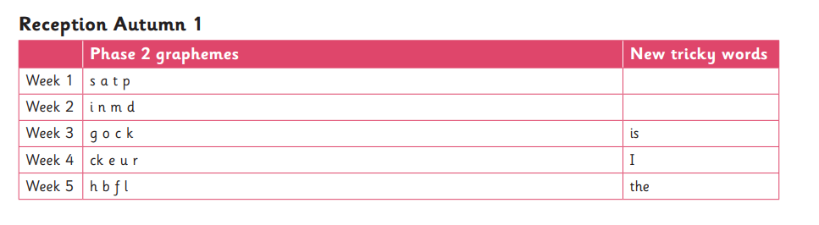
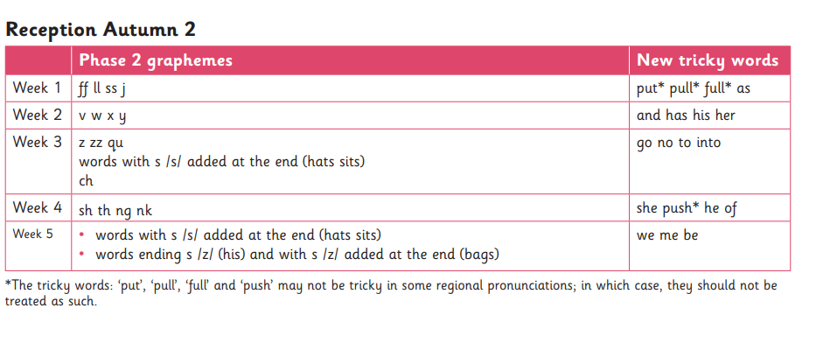
Phonics

Slide 17
Reading
Reading is extremely important in the Early Years and we aim to foster a real love of books and a desire to read.
Children will read three times in school during the week (the same book). This develops automaticity and accuracy.
The three guided reading sessions teaches the skills needed to read and also develops the understanding of texts.
1st reading- decoding the text.
2nd reading- prosody- reading with meaning, stress, intonation/expression.
3rd reading- comprehension-understanding the text.
The guided reading books match the progression of the phonics programme.
Wordless Books- Children who are not yet blending.
Blending Practise Books- Most children should be blending by Christmas and begin reading phase 2 decodable books.
Decodable Books- Children confident at blending will then read the decodable books.
Children will be given books with the GPC’s that have already been taught.

Slide 18
Reading
Reading at home is crucial. It makes a huge difference to their progress . It is very clear who reads regularly and who doesn’t by their level of skill and confidence.
We will be introducing an ‘Aiming High’ challenge- at Goldenhill, we ask that children read at least 4 times every week. Every time children read, they will move their name up the chart. When they reach the top, they will be rewarded with a prize.
Please fill in the children’s reading diaries. Children need to bring their book bag into school every day.

Slide 19
Assessment
From September 2021 the statutory Reception Baseline Assessment came into school. This is a one to one assessment with myself in a nonthreatening way and uses pictures, teddies and other apparatus to assess early literacy and numeracy. This is then repeated at the end of the school year.
In class we are constantly assessing the children.
Children’s written work is recorded in their Literacy and Maths books, again with photos as appropriate. We will use DOJO as a communication between home and school – please let me know if you need a password reset. Please return your permission letter for DOJO.
Children are assessed informally on a daily basis and a summary of their developmental level is decided on a termly basis for each area of learning.
This assessment level is recorded as ‘on track’ or ‘not on track.’

Slide 20
Behaviour Management
Dojo’s: These can be given by any member of staff and reward any type of good behaviour or effort. The children have an electronic character which they can add their dojo’s to. At the end of the week, the children who have achieved 10 or more DOJO’s, will receive an award.
Marble jar: This is a whole class reward system where they work together as a team to gain marbles. They have a half termly treat which they choose.
• Behaviour system- All children start on the ‘Sunshine’. If they are not following the school rules they will receive a verbal warning. If this continues they will get a second warning and then if they still continue they will move their photo to the ‘Rain cloud’. If they still choose to continue, the child will move their photo to the ‘Thunder cloud’. This will mean they will receive a behaviour point and will lose minutes off their outdoor play. For severe behaviour e.g. deliberately hurting others, their photo will move instantly to the ‘Thunder cloud’ and SLT may be involved.
Stickers are also rewarded daily for kindness, pupil engagement and effort.

Slide 21
PE
This half term, PE will be on a Wednesday afternoon. This will be gymnastics in the hall.
The children can come to school in PE kit on PE days.
Please ensure the children do not wear jewellery for PE. If they have earrings for recently pieced ears, they must cover their earrings up at home.

Slide 22
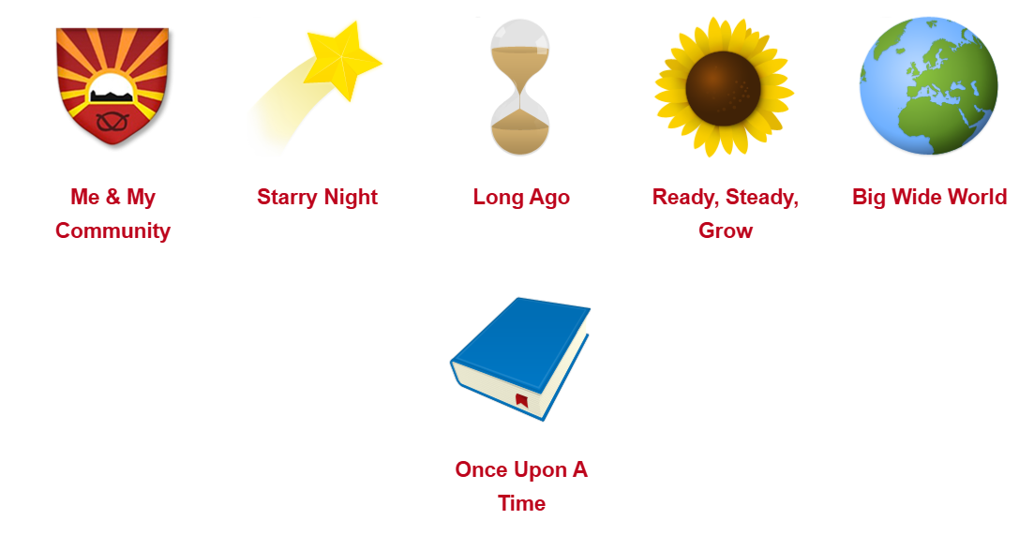
Topics

Slide 23
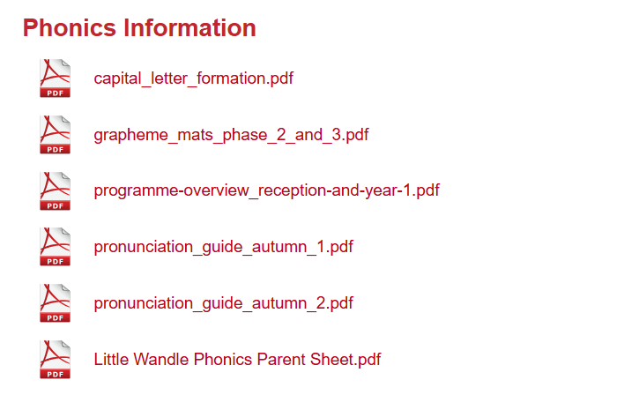
School Website

Slide 24
Parents
You are your child’s biggest educator, therefore working together is crucial.
How you can help your child at home
Daily reading of their reading book and phonics sheets
Practising phonics at home
Ensuring all homework is completed and returned on time / shared on DOJO.
Sharing books regularly to foster a love of stories
Counting and recognising numbers, coins, shapes, days of week, clock faces – new maths activities to come.
Please let us know when your child does something amazing at home – it could be swimming certificates, doing up their buttons for the first time, riding their bike without stabilisers, cutting their own food etc.
Your input is crucial in their learning journey and helps to give us a clear picture of your child.

Slide 25
Essentials
Please bring only essential items into school
Book bag each day.
Water bottles – named please
Uniform – clearly named please
Coat-clearly named please
Snack-Healthy snack only please

Slide 26
Donations
We would be most grateful for any of the following:
Dolls, doll’s clothes, doll’s bedding, doll’s prams.
Dressing up clothes.
Construction sets.
Building blocks/bricks.
Small world sets e.g. castle, farm.
Home corner equipment such as tea sets, iron, ironing board, saucepans, plastic food, cutlery.
Metal saucepans, pots, baking trays, utensils- for the outside Mud kitchen.
Bats, balls and other small physical equipment.
Wheeled vehicles/ride on equipment
Gardening equipment.
Wooden jigsaws.
Games
Plastic boxes for storage (preferably with lids)- we need lots of these.
Or anything else you can think of!
We would absolutely appreciate any donations and would be extremely grateful.

Slide 27
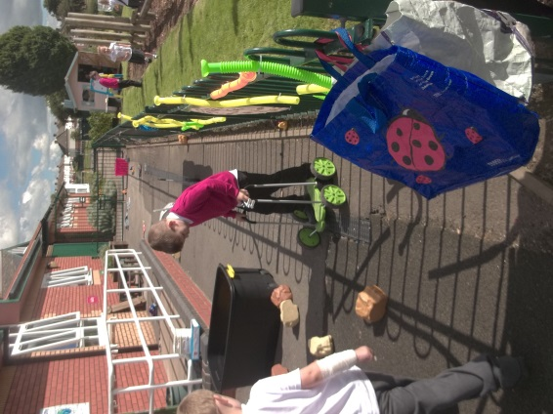
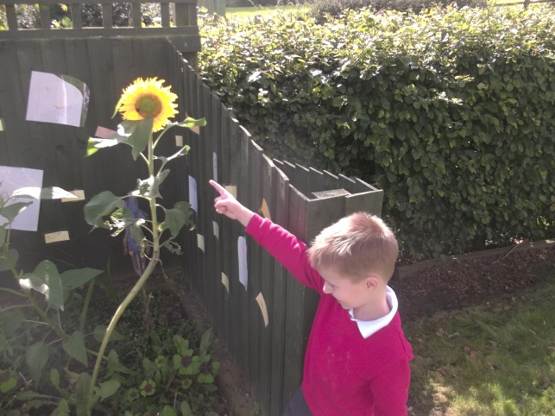
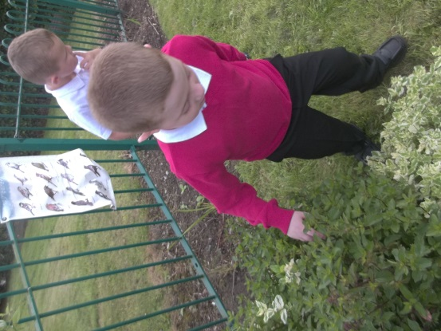
Thank you
Thank you very much for coming today.
If you have any questions or concerns and wish to discuss things further please do not hesitate to ask.
Many thanks for all your continued support.

