Slide 1







H
E
L
L
O
Welcome to Year 3

Slide 2

We will go through:
- Weekly Timetable
- Year 3 Topics / Topic Web
- Maths and Reading
- Assessment
- PE
- Behaviour
- Homework
-How can you help?
-Questions

Slide 3
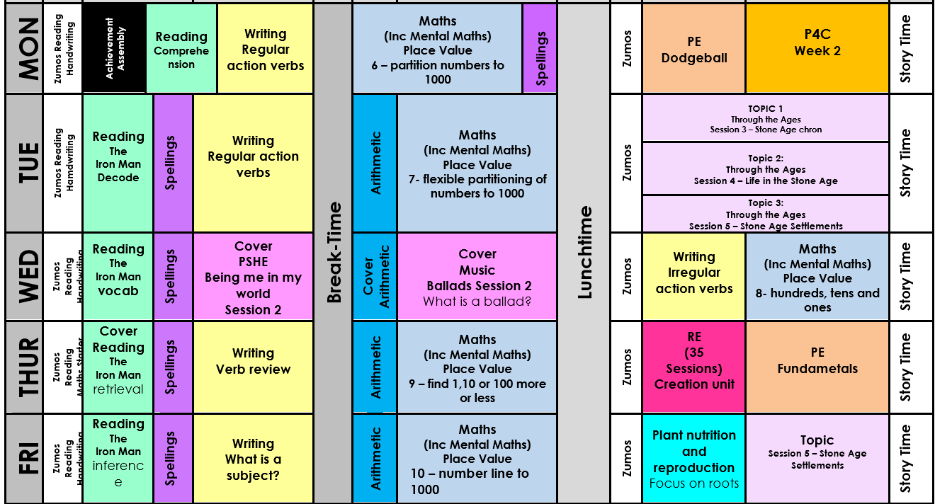
Weekly Timetable

Slide 4



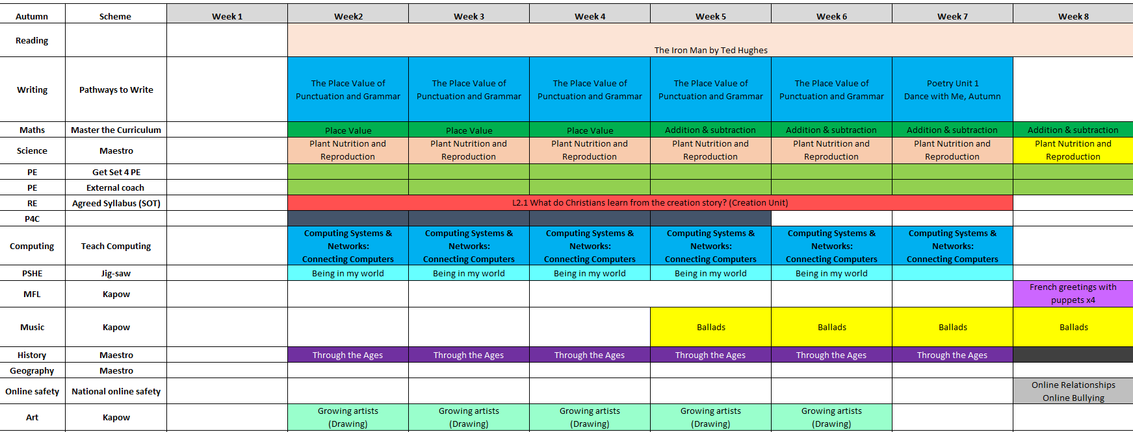






What is your child learning in this term?

Slide 5


Slide 6

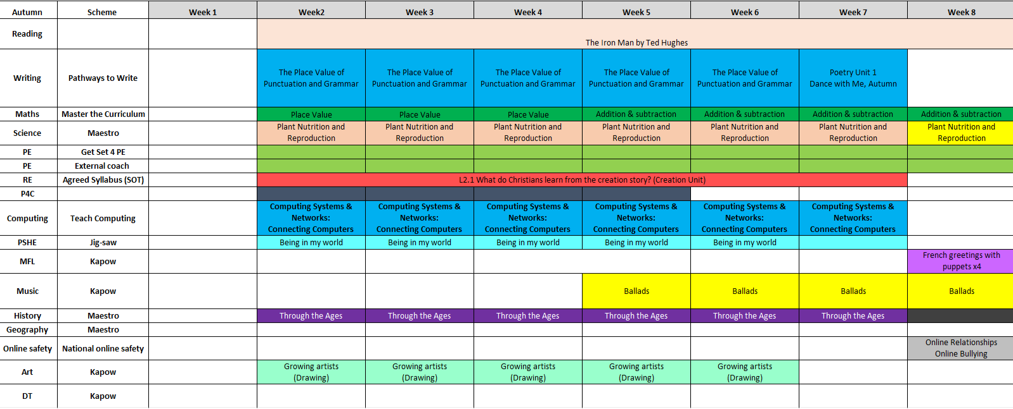


Slide 7

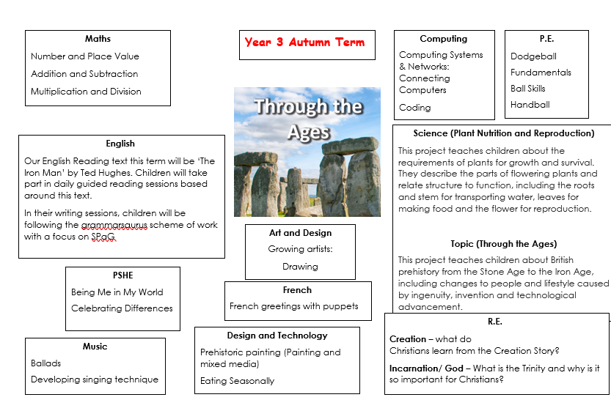

Topic Web for the term

Slide 8
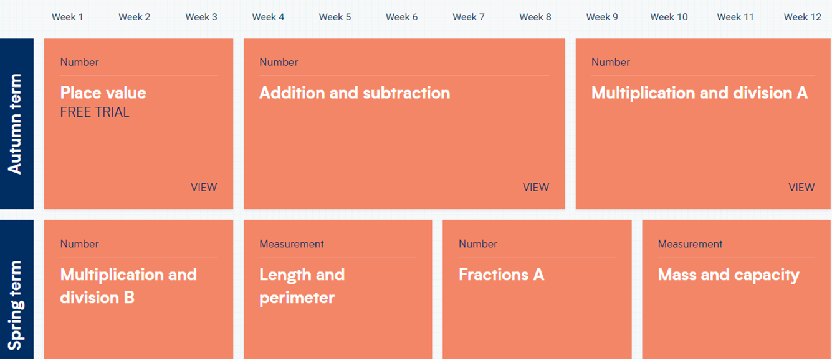


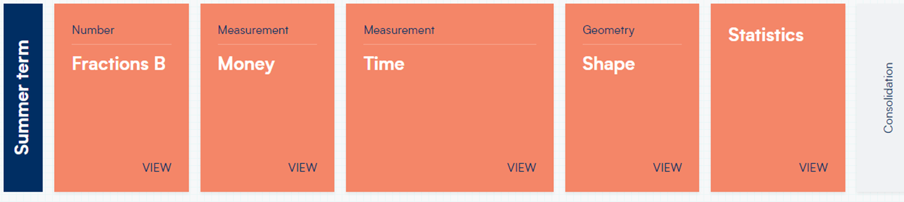
Maths (5 lessons per week)
Arithmetic 2x a week

Slide 9





Monday: Cold Comprehension
Tuesday: Decoding
Wednesday Vocabulary
Thursday: Retrieval
Friday: Inference
Accelerated Reader
Daily opportunities to read AR Book
Access to AR quiz
Reading books must come back to school every day – children will sign their own diaries when they read at school.
Please continue to sign them at home.

Slide 10




AR Test
◦Each book that a child reads gives access to a ‘test’, which is a comprehension activity based on the book.
◦Each half term, children take a ‘star reading test’ based on the scores they have so far. This shows us their reading age and affects which books they bring home!
◦The results of these tests help to build up a bank of achievements which provide the evidence used to provide an accurate assessment of your child’s ability at the end of each half term.

Slide 11
Writing
We use a pathways to write program., which follows a mastery approach to writing. Children write five times a week, using high quality texts, with repeated practice to build and master key skills.
Spelling
We use pathways to spell, which follows a clear, progressive program.
Poetry
Each year group completes 4 poetry units, focusing on vocabulary, performance and collaboration
Grammar and Punctuation
In the first half of the Autumn Term, we focus on closing any gaps in grammar and sentence skills through 20 targeted lessons.
Handwriting
We use the letter join scheme, with a goal for all pupils to produce fluent and legible handwriting by the end of Key Stage 2.

Slide 12
Termly Assessment
Maths Assessment
◦Termly assessments completed through White Rose Maths (inline with teaching)
Reading Assessment
◦Progress in Reading Assessment (PIRA) . This is similar to the PUMA Maths test.
Writing Assessment
◦Produce four/five formal pieces of writing.

Slide 13
Assessment at Goldenhill
Assessment Data is taken at three points in the year.
Age Related Expectations (ARE)
(B) Below
(WT) Working Towards
(EXP) Expected Standard
(HS) Higher Standard

Slide 14
Writing in Year 3: Vocabulary, Grammar and punctuation
Year 3 objectives:
◦extending the range of sentences with more than one clause by using a wider range of conjunctions, including when, if, because, although
◦choosing nouns or pronouns appropriately for clarity and cohesion and to avoid repetition
◦using conjunctions, adverbs and prepositions to express time and cause (and place)
◦
◦• using the present perfect form of verbs in contrast to the past tense
• form nouns using prefixes (super-, anti-)
• use the correct form of 'a' or 'an'
• word families based on common words (solve, solution, dissolve, insoluble)
• using and punctuating direct speech (i.e. Inverted commas)

Slide 15

Year 3 objectives:
• discussing writing similar to that which they are planning to write in order to understand and learn from its structure, vocabulary and grammar
• discussing and recording ideas
• composing and rehearsing sentences orally (including dialogue), progressively building a varied and rich vocabulary and an increasing range of sentence structures
• organising paragraphs around a theme
• in narratives, creating settings, characters and plot
• in non-narrative material, using simple organisational devices (headings & subheadings)
• assessing the effectiveness of their own and others’ writing and suggesting improvements
• proposing changes to grammar and vocabulary to improve consistency, including the accurate use of pronouns in sentences
• proofread for spelling and punctuation errors

Slide 16
Writing in year 3: Spelling
Year 3 objectives:
◦ spell further homophones
◦ spell words that are often misspelt
• use further prefixes and suffixes and understand how to add them
◦ place the possessive apostrophe accurately in words with regular plurals and in words with irregular plurals
◦use the first 2 or 3 letters of a word to check its spelling in a dictionary

Slide 17
Writing in year 3: Handwriting
Year 3 objectives:
◦use the diagonal and horizontal strokes that are needed to join letters and understand which letters, when adjacent to one another, are best left unjoined.
◦increase the legibility, consistency and quality of their handwriting.

Slide 18
Maths: Number
Year 3 objectives:
-
•Identify, represent and estimate numbers using different representations.
•Find 10 or 100 more or less than a given number
•Recognise the place value of each digit in a three-digit number (hundreds, tens, ones).
•Compare and order numbers up to 1000
•Read and write numbers up to 1000 in numerals and in words.
•Solve number problems and practical problems involving these ideas.
•Count from 0 in multiples of 4, 8, 50 and 100

Slide 19
Maths: Key Vocabulary and skills – Addition, Subtraction, Multiplication and Division
Year 3 Objectives
◦Add and subtract numbers mentally, including: a three-digit number and ones; a three-digit number and tens; a three digit number and hundreds.
◦Add and subtract numbers with up to three digits, using formal written methods of columnar addition and subtraction.
◦Estimate the answer to a calculation and use inverse operations to check answers.
◦Solve problems, including missing number problems, using number facts, place value, and more complex addition and subtraction.
◦Recall and use multiplication and division facts for the 3, 4 and 8 multiplication tables.
◦Write and calculate mathematical statements for multiplication and division using the multiplication tables they know, including for two-digit numbers times one-digit numbers, using mental and progressing to formal written methods.
◦Solve problems, including missing number problems, involving multiplication and division, including positive integer scaling problems and correspondence problems in which n objects are connected to m objectives.

Slide 20
Maths: Fractions
Year 3 objectives:
•Count up and down in tenths; recognise that tenths arise from dividing an object into 10 equal parts and in dividing one-digit numbers or quantities by 10
•Recognise and use fractions as numbers: unit fractions and non-unit fractions with small denominators.
•Recognise, find and write fractions of a discrete set of objects: unit fractions and non-unit fractions with small denominators.
•Solve problems that involve all of the above.

Slide 21
Maths: Geometry properties of shape
Year 3 objectives:
•Recognise angles as a property of shape or a description of a turn.
•Identify right angles, recognise that two right angles make a half-turn, three make three quarters of a turn and four a complete turn; identify whether angles are greater than or less than a right angle.
•Identify horizontal and vertical lines and pairs of perpendicular and parallel lines.
•Draw 2-D shapes and make 3-D shapes using modelling materials.
•Recognise 3-D shapes in different orientations and describe them.

Slide 22
















Maths: Measurement
•Year 3 objectives:
•
•Add and subtract amounts of money to give change, using both £ and p in practical contexts.
•Measure, compare, add and subtract: lengths (m/cm/mm); mass (kg/g); volume/capacity (l/ml).
•Measure the perimeter of simple 2D shapes.
•Tell and write the time from an analogue clock, including using Roman numerals from I to XII and 12-hour and 24-hour clocks.
•Estimate and read time with increasing accuracy to the nearest minute.
•Record and compare time in terms of seconds, minutes and hours.
•Use vocabulary such as o’clock, a.m./p.m., morning, afternoon, noon and midnight.
•Know the number of seconds in a minute and the number of days in each month, year and leap year.
•Compare durations of events [for example to calculate the time taken by particular events or tasks.

Slide 23
Maths: Statistics
Year 3 objectives:
•Interpret and present data using bar charts, pictograms and tables.
•Solve one-step and two-step questions [for example, ‘How many more?’ and ‘How many fewer?’ using information presented in scaled bar charts and pictograms and tables.

Slide 24
PE
Autumn
Spring
Summer

Slide 25
Behaviour
◦Dojo’s: These can be given by any member of staff and reward any type of good behaviour or effort. The children have an electronic character which they can add their dojo’s to. Top Dojo winner gets a certificate each week.
◦Marble jar: This is a whole class reward system where they work together as a team to gain marbles
Pupils who do not demonstrate acceptable or appropriate behavior will be monitored through the In Class System:
  Warning.
  . Second warning.
  Third warning: move to orange on the behaviour chart.
  . Fourth warning: move to red on the behaviour chart and behaviour point issued.
  Fifth warning another behaviour point is issued. The pupil will be asked to take some ‘time out’ in another classroom. If the child, following their return to the class setting, continued to demonstrate inappropriate behaviour, a member of SLT will be called to remove the child from the class to have ‘time out’ with them.

Slide 26
Homework
Weekly Expectations
-Reading (at least 4 times a week)
-Times tables (TTRS)
-
2 set pieces of homework, which may include:
-English activities
-Maths activities
-Topic activities- research and creative activities (you may be given up to 2 weeks to complete these).
Homework will be given out on a Friday and will be due in the following Wednesday.

Slide 27
How can you help?
- Handwriting practise
- Encouraging good presentation e.g. Homework
- Reading at home
- Times table practise
- Spelling practise
-Communication

Slide 28
Thank You
Any Question?

